Slide 1

LUNG TRANSPLANTATION
Adult Recipients
2017
JHLT. 2017 Oct; 36(10): 1037-1079

Slide 2
Table of Contents
Donor, recipient and center characteristics: slides 3-17
Post-transplant survival and rejection: slides 18-42
Functional and employment status and rehospitalization post transplant: slides 43-46
Induction and maintenance immunosuppression: slides 47-65
Post transplant morbidities: slides 66-88
Multivariable analyses: slides 89-135
Focus theme: slides 136-149
2017
JHLT. 2017 Oct; 36(10): 1037-1079

Slide 3
Donor, Recipient and Center Characteristics
2017
JHLT. 2017 Oct; 36(10): 1037-1079

Slide 4
Adult Lung Transplants Number of Transplants by Year and Procedure Type
NOTE: This figure includes only the adult lung transplants that are reported to the ISHLT Transplant Registry. As such, this should not be construed as representing changes in the number of adult lung transplants performed worldwide.
2017
JHLT. 2017 Oct; 36(10): 1037-1079

Slide 5
Adult Lung Retransplants Retransplants by Year and Location
2017
JHLT. 2017 Oct; 36(10): 1037-1079

Slide 6
Adult Lung Retransplants Retransplants by Inter-transplant Interval
(Retransplants: January 1990 – June 2016)
2017
JHLT. 2017 Oct; 36(10): 1037-1079

Slide 7
Adult Lung Transplants
Average Center Volume by Location
(Transplants: January 2009 – June 2016)
2017
JHLT. 2017 Oct; 36(10): 1037-1079

Slide 8
Adult Lung Transplants
Indications
(Transplants: January 1995 – June 2016)
Diagnosis | SLT (N=18,207) | BLT (N=36,046) | TOTAL (N=54,253)
COPD | 7,266 (39.9%) | 9,539 (26.5%) | 16,805 (31.0%)
IIP | 6,449 (35.4%) | 6,990 (19.4%) | 13,439 (24.8%)
CF | 218 (1.2%) | 8,266 (22.9%) | 8,484 (15.6%)
ILD-not IIP | 1,078 (5.9%) | 1,925 (5.3%) | 3,003 (5.5%)
A1ATD | 797 (4.4%) | 1,912 (5.3%) | 2,709 (5.0%)
Retransplant | 922 (5.1%) | 1,269 (3.5%) | 2,191 (4.0%)
IPAH | 88 (0.5%) | 1,481 (4.1%) | 1,569 (2.9%)
Non CF-bronchiectasis | 67 (0.4%) | 1,413 (3.9%) | 1,480 (2.7%)
Sarcoidosis | 312 (1.7%) | 1,026 (2.8%) | 1,338 (2.5%)
PH-not IPAH | 135 (0.7%) | 690 (1.9%) | 825 (1.5%)
LAM/tuberous sclerosis | 146 (0.8%) | 381 (1.1%) | 527 (1.0%)
OB | 73 (0.4%) | 395 (1.1%) | 468 (0.9%)
CTD | 140 (0.8%) | 282 (0.8%) | 422 (0.8%)
Cancer | 7 (0.0%) | 27 (0.1%) | 34 (0.1%)
Other | 509 (2.8%) | 450 (1.2%) | 959 (1.8%)
2017
JHLT. 2017 Oct; 36(10): 1037-1079
Notes:
Transplants with unknown diagnoses are excluded from this tabulation.

Slide 9
Adult Lung Transplants Distribution of Procedure Type for Major Indications by Year
Year of TX | A1ATD |  | COPD |  | CF |  | IIP |  | ILD-not IIP
 | Double (%) | Single (%) | Double (%) | Single (%) | Double (%) | Single (%) | Double (%) | Single (%) | Double (%) | Single (%)
2001 | 59.9 | 40.1 | 30.2 | 69.8 | 94.5 | 5.5 | 31.6 | 68.4 | 36.2 | 63.8
2002 | 57.0 | 43.0 | 39.1 | 60.9 | 97.1 | 2.9 | 35.2 | 64.8 | 54.2 | 45.8
2003 | 66.4 | 33.6 | 43.2 | 56.8 | 96.1 | 3.9 | 42.9 | 57.1 | 44.1 | 55.9
2004 | 74.8 | 25.2 | 45.6 | 54.4 | 96.5 | 3.5 | 45.1 | 54.9 | 59.4 | 40.6
2005 | 76.9 | 23.1 | 49.5 | 50.5 | 97.5 | 2.5 | 46.8 | 53.2 | 57.4 | 42.6
2006 | 71.8 | 28.2 | 58.4 | 41.6 | 98.5 | 1.5 | 47.9 | 52.1 | 69.1 | 30.9
2007 | 82.5 | 17.5 | 63.5 | 36.5 | 97.9 | 2.1 | 49.1 | 50.9 | 64.5 | 35.5
2008 | 79.8 | 20.2 | 65.4 | 34.6 | 98.8 | 1.2 | 52.4 | 47.6 | 62.3 | 37.7
2009 | 87.2 | 12.8 | 66.4 | 33.6 | 99.8 | 0.2 | 52.0 | 48.0 | 64.7 | 35.3
2010 | 85.8 | 14.2 | 70.3 | 29.7 | 99.6 | 0.4 | 56.0 | 44.0 | 65.8 | 34.2
2011 | 89.9 | 10.1 | 73.3 | 26.7 | 98.8 | 1.2 | 54.9 | 45.1 | 69.4 | 30.6
2012 | 91.5 | 8.5 | 74.4 | 25.6 | 98.3 | 1.7 | 60.2 | 39.8 | 70.0 | 30.0
2013 | 89.8 | 10.2 | 76.5 | 23.5 | 99.2 | 0.8 | 59.3 | 40.7 | 67.8 | 32.2
2014 | 87.1 | 12.9 | 79.4 | 20.6 | 98.8 | 1.2 | 61.6 | 38.4 | 67.4 | 32.6
2015 | 93.2 | 6.8 | 77.2 | 22.8 | 98.9 | 1.1 | 62.0 | 38.0 | 73.8 | 26.2
2017
JHLT. 2017 Oct; 36(10): 1037-1079

Slide 10
Adult Lung Transplants Procedure Type within Indication, by Year
2017
JHLT. 2017 Oct; 36(10): 1037-1079

Slide 11
Adult Lung Transplants Diagnosis Distribution by Procedure Type
(Transplants: January 1995 – June 2016)
2017
JHLT. 2017 Oct; 36(10): 1037-1079
Notes:
Transplants with unknown procedure types and diagnoses are excluded from this tabulation.

Slide 12
Adult Lung Transplants Major Indications by Year (%)
2017
JHLT. 2017 Oct; 36(10): 1037-1079

Slide 13
Adult Lung Transplants Major Indications by Year (Number)
2017
JHLT. 2017 Oct; 36(10): 1037-1079

Slide 14
Adult Lung Transplants Diagnosis Distribution by Location
(Transplants: January 2004 – June 2016)
2017
JHLT. 2017 Oct; 36(10): 1037-1079
Notes:
Transplants with unknown diagnoses are excluded from this tabulation.

Slide 15
Adult Lung Transplants Diagnosis Distribution by Location and Era
(Transplants: January 2004 – June 2016)
2017
JHLT. 2017 Oct; 36(10): 1037-1079
Notes:
Transplants with unknown diagnoses are excluded from this tabulation.

Slide 16
Adult Lung Transplants Transplant Type Distribution by Recipient Age Group
(Transplants: January 1990 – June 2016)
2017
JHLT. 2017 Oct; 36(10): 1037-1079

Slide 17
Adult Lung Transplants Transplant Type Distribution by Location
(Transplants: January 1990 – June 2016)
2017
JHLT. 2017 Oct; 36(10): 1037-1079

Slide 18
Post-Transplant Survival and Rejection
2017
JHLT. 2017 Oct; 36(10): 1037-1079

Slide 19
Adult Lung Transplants Kaplan-Meier Survival by Procedure Type for Primary
Transplant Recipients
(Transplants: January 1990 – June 2015)
Median survival (years):
Double Lung = 7.4; Conditional = 9.9 Single Lung = 4.6; Conditional = 6.4
p<0.0001
2017
JHLT. 2017 Oct; 36(10): 1037-1079
Notes:
Survival was calculated using the Kaplan-Meier method, which incorporates information from all transplants for whom any follow-up has been provided. Since many patients are still alive and some patients have been lost to follow-up, the survival rates are estimates rather than exact rates because the time of death is not known for all patients.
The median survival is the estimated time point at which 50% of all of the recipients have died. The conditional median survival is the estimated time point at which 50% of the recipients who survive to at least 1 year have died. Because the decline in survival is greatest during the first year following transplantation, the conditional survival provides a more realistic expectation of survival time for recipients who survive the early post-transplant period.
Survival rates were compared using the log-rank test statistic.

Slide 20
Adult Lung Transplants Kaplan-Meier Survival by Transplant Type
(Transplants: January 1990 – June 2015)
Median survival (years):
Primary: 6.0; Conditional = 8.1 Retransplant: 2.9; Conditional = 6.5
p<0.0001
2017
JHLT. 2017 Oct; 36(10): 1037-1079
Notes:
Survival was calculated using the Kaplan-Meier method, which incorporates information from all transplants for whom any follow-up has been provided. Since many patients are still alive and some patients have been lost to follow-up, the survival rates are estimates rather than exact rates because the time of death is not known for all patients.
The median survival is the estimated time point at which 50% of all of the recipients have died. The conditional median survival is the estimated time point at which 50% of the recipients who survive to at least 1 year have died. Because the decline in survival is greatest during the first year following transplantation, the conditional survival provides a more realistic expectation of survival time for recipients who survive the early post-transplant period.
Survival rates were compared using the log-rank test statistic. Adjustments for multiple comparisons were done using Scheffe’s method.

Slide 21
Adult Lung Transplants Kaplan-Meier Survival by Era
(Transplants: January 1990 – June 2015)
Median survival (years):
1990-1998: 4.2; Conditional=7.1; 1999-2008: 6.1; Conditional=8.5; 2009-6/2015: NA; Conditional=NA
1990-1998 vs. 1999-2008: p<0.0001; 1990-1998 vs. 2009-6/2015: p<0.0001; 1999-2008 vs. 2009-6/2015: p<0.0001
2017
JHLT. 2017 Oct; 36(10): 1037-1079
Notes:
Survival was calculated using the Kaplan-Meier method, which incorporates information from all transplants for whom any follow-up has been provided. Since many patients are still alive and some patients have been lost to follow-up, the survival rates are estimates rather than exact rates because the time of death is not known for all patients.
The median survival is the estimated time point at which 50% of all of the recipients have died. The conditional median survival is the estimated time point at which 50% of the recipients who survive to at least 1 year have died. Because the decline in survival is greatest during the first year following transplantation, the conditional survival provides a more realistic expectation of survival time for recipients who survive the early post-transplant period.
Survival rates were compared using the log-rank test statistic. Adjustments for multiple comparisons were done using Scheffe’s method.

Slide 22
Adult Lung Transplants Kaplan-Meier Survival by Era and Transplant Type
(Transplants: January 1990 – June 2015)
All pair-wise comparisons between transplant types within each era and between eras within each transplant type were significant at p < 0.05 except for
Retx: 1999-2008 vs. 2009-6/2015
Median survival (years):
Primary: 1990-1998 = 4.3; 1999-2008 = 6.2; 2009-6/2015 = NA; Retx: 1990-1998 = 1.0; 1999-2008 = 3.4; 2009-6/2015 = 3.2
2017
JHLT. 2017 Oct; 36(10): 1037-1079
Notes:
Survival was calculated using the Kaplan-Meier method, which incorporates information from all transplants for whom any follow-up has been provided. Since many patients are still alive and some patients have been lost to follow-up, the survival rates are estimates rather than exact rates because the time of death is not known for all patients. The median survival is the estimated time point at which 50% of all of the recipients have died.
Survival rates were compared using the log-rank test statistic. Adjustments for multiple comparisons were done using Bonferroni method.

Slide 23
Adult Lung Transplants Kaplan-Meier Survival Conditional on Survival to 1 Year by Era and Transplant Type
(Transplants: January 1990 – June 2015)
All pair-wise comparisons between transplant types within each era and between eras within each transplant type were significant at p < 0.05 except for
1990-1998: Primary vs. Retransplant
Primary: 1999-2008 vs. 2009-6/2015
Retx: 1990-1998 vs. 1999-2008
Retx: 1990-1998 vs. 2009-6/2015
Median survival (years):
Primary: 1990-1998 = 7.1; 1999-2008 = 8.6; 2009-6/2015 = NA; Retx: 1990-1998 = 6.1; 1999-2008 = 7.1; 2009-6/2015 = 5.3
2017
JHLT. 2017 Oct; 36(10): 1037-1079
Notes:
Survival was calculated using the Kaplan-Meier method, which incorporates information from all transplants for whom any follow-up has been provided. Since many patients are still alive and some patients have been lost to follow-up, the survival rates are estimates rather than exact rates because the time of death is not known for all patients. The median survival is the estimated time point at which 50% of all of the recipients have died.
Survival rates were compared using the log-rank test statistic. Adjustments for multiple comparisons were done using Bonferroni method.

Slide 24
Adult Lung Transplants Kaplan-Meier Survival by Gender
(Transplants: January 1990 – June 2015)
p<0.0001
Median survival (years): Male=5.6; Female=6.2
2017
JHLT. 2017 Oct; 36(10): 1037-1079
Notes:
Survival was calculated using the Kaplan-Meier method, which incorporates information from all transplants for whom any follow-up has been provided. Since many patients are still alive and some patients have been lost to follow-up, the survival rates are estimates rather than exact rates because the time of death is not known for all patients. The median survival is the estimated time point at which 50% of all of the recipients have died.
Survival rates were compared using the log-rank test statistic.

Slide 25
Adult Lung Transplants Kaplan-Meier Survival by Transplant Type and Gender
(Transplants: January 1990 – June 2015)
All pair-wise comparisons were significant at p < 0.05 except
Retx: Male vs. Female
Median survival (years):
Primary: Male=5.7, Female=6.4; First Retx: Male=2.9, Female=2.9
2017
JHLT. 2017 Oct; 36(10): 1037-1079
Notes:
Survival was calculated using the Kaplan-Meier method, which incorporates information from all transplants for whom any follow-up has been provided. Since many patients are still alive and some patients have been lost to follow-up, the survival rates are estimates rather than exact rates because the time of death is not known for all patients. The median survival is the estimated time point at which 50% of all of the recipients have died.
Survival rates were compared using the log-rank test statistic. Adjustments for multiple comparisons were done using Scheffe’s method.

Slide 26
Adult Lung Transplants Kaplan-Meier Survival by Diagnosis
(Transplants: January 1990 – June 2015)
Median survival (years):
A1ATD: 6.7; CF: 9.2; COPD: 5.8; IIP: 4.9; ILD-not IIP: 6.0; Retransplant: 2.9
All pair-wise comparisons were significant at p < 0.05 except A1ATD vs. ILD-non IIP and COPD vs. ILD-non IIP
2017
JHLT. 2017 Oct; 36(10): 1037-1079
Notes:
Survival was calculated using the Kaplan-Meier method, which incorporates information from all transplants for whom any follow-up has been provided. Since many patients are still alive and some patients have been lost to follow-up, the survival rates are estimates rather than exact rates because the time of death is not known for all patients. The median survival is the estimated time point at which 50% of all of the recipients have died.
Survival rates were compared using the log-rank test statistic. Adjustments for multiple comparisons were done using Scheffe’s method. Results of log-rank test should be interpreted with caution when curves cross. Only pair-wise comparisons statistically significant at p < 0.05 are shown on the slide.

Slide 27
Adult Lung Transplants Kaplan-Meier Survival by Diagnosis Conditional on
Survival to 3 Months
(Transplants: January 1990 – June 2015)
All pair-wise comparisons were significant at p < 0.05 except A1ATD vs. ILD-non IIP, COPD vs. IIP and COPD vs. ILD-non IIP
Median survival (years): A1ATD: 8.0; CF: 10.6; COPD: 6.4; IIP: 6.1; ILD-not IIP: 7.0; Retransplant: 5.0
2017
JHLT. 2017 Oct; 36(10): 1037-1079
Notes:
Survival was calculated using the Kaplan-Meier method, which incorporates information from all transplants for whom any follow-up has been provided. Since many patients are still alive and some patients have been lost to follow-up, the survival rates are estimates rather than exact rates because the time of death is not known for all patients. This figure shows survival conditional on survival to 3 months. Therefore, only patients surviving to at least 3 months were included in the calculation. The conditional median survival is the estimated time point at which 50% of the recipients who survive to at least 3 months have died.
Survival rates were compared using the log-rank test statistic. Adjustments for multiple comparisons were done using Scheffe’s method.

Slide 28
Adult Lung Transplants Kaplan-Meier Survival by Diagnosis Conditional on
Survival to 1 Year
(Transplants: January 1990 – June 2015)
All pair-wise comparisons were significant at p < 0.05 except A1ATD vs. ILD-non IIP, COPD vs. IIP, COPD vs. Retransplant and IIP vs. Retransplant
Median survival (years): A1ATD: 8.9; CF: 12.0; COPD: 7.2; IIP: 7.1; ILD-not IIP: 8.1; Retransplant: 6.5
2017
JHLT. 2017 Oct; 36(10): 1037-1079
Notes:
Survival was calculated using the Kaplan-Meier method, which incorporates information from all transplants for whom any follow-up has been provided. Since many patients are still alive and some patients have been lost to follow-up, the survival rates are estimates rather than exact rates because the time of death is not known for all patients. This figure shows survival conditional on survival to 12 months. Therefore, only patients surviving to at least 12 months were included in the calculation. The conditional median survival is the estimated time point at which 50% of the recipients who survive to at least 12 months have died.
Survival rates were compared using the log-rank test statistic. Adjustments for multiple comparisons were done using Scheffe’s method.

Slide 29
Adult Lung Transplants Kaplan-Meier Survival by Procedure Type
Diagnosis: A1ATD
(Transplants: January 1990 – June 2015)
p<0.0001
2017
JHLT. 2017 Oct; 36(10): 1037-1079
Notes:
Survival was calculated using the Kaplan-Meier method, which incorporates information from all transplants for whom any follow-up has been provided. Since many patients are still alive and some patients have been lost to follow-up, the survival rates are estimates rather than exact rates because the time of death is not known for all patients.
Survival rates were compared using the log-rank test statistic.

Slide 30
Adult Lung Transplants Kaplan-Meier Survival by Procedure Type
Diagnosis: COPD
(Transplants: January 1990 – June 2015)
p<0.0001
2017
JHLT. 2017 Oct; 36(10): 1037-1079
Notes:
Survival was calculated using the Kaplan-Meier method, which incorporates information from all transplants for whom any follow-up has been provided. Since many patients are still alive and some patients have been lost to follow-up, the survival rates are estimates rather than exact rates because the time of death is not known for all patients.
Survival rates were compared using the log-rank test statistic.

Slide 31
Adult Lung Transplants Kaplan-Meier Survival by Procedure Type and Era
Diagnosis: COPD, Single Lung
(Transplants: January 1990 – June 2015)
1990-1998 vs. 1999-2008: p<0.0001 1990-1998 vs. 2009-6/2015: p<0.0001 1999-2008 vs. 2009-6/2015: p = 0.8768
2017
JHLT. 2017 Oct; 36(10): 1037-1079
Notes:
Survival was calculated using the Kaplan-Meier method, which incorporates information from all transplants for whom any follow-up has been provided. Since many patients are still alive and some patients have been lost to follow-up, the survival rates are estimates rather than exact rates because the time of death is not known for all patients.
Survival rates were compared using the log-rank test statistic. Adjustments for multiple comparisons were done using Scheffe’s method.

Slide 32
Adult Lung Transplants Kaplan-Meier Survival by Procedure Type and Era
Diagnosis: COPD, Bilateral/Double Lung
(Transplants: January 1990 – June 2015)
1990-1998 vs. 1999-2008: p = 0.0017 1990-1998 vs. 2009-6/2015: p = 0.0037 1999-2008 vs. 2009-6/2015: p = 0.2717
2017
JHLT. 2017 Oct; 36(10): 1037-1079
Notes:
Survival was calculated using the Kaplan-Meier method, which incorporates information from all transplants for whom any follow-up has been provided. Since many patients are still alive and some patients have been lost to follow-up, the survival rates are estimates rather than exact rates because the time of death is not known for all patients.
Survival rates were compared using the log-rank test statistic. Adjustments for multiple comparisons were done using Scheffe’s method.

Slide 33
Adult Lung Transplants Kaplan-Meier Survival by Procedure Type
Diagnosis: IIP
(Transplants: January 1990 – June 2015)
p<0.0001
2017
JHLT. 2017 Oct; 36(10): 1037-1079
Notes:
Survival was calculated using the Kaplan-Meier method, which incorporates information from all transplants for whom any follow-up has been provided. Since many patients are still alive and some patients have been lost to follow-up, the survival rates are estimates rather than exact rates because the time of death is not known for all patients.
Survival rates were compared using the log-rank test statistic.

Slide 34
Adult Lung Transplants Kaplan-Meier Survival by Procedure Type and Era
Diagnosis: IIP, Single Lung
(Transplants: January 1990 – June 2015)
1990-1998 vs. 1999-2008: p = 0.0015
1990-1998 vs. 2009-6/2015: p = 0.0002 1999-2008 vs. 2009-6/2015: p = 0.8925
2017
JHLT. 2017 Oct; 36(10): 1037-1079
Notes:
Survival was calculated using the Kaplan-Meier method, which incorporates information from all transplants for whom any follow-up has been provided. Since many patients are still alive and some patients have been lost to follow-up, the survival rates are estimates rather than exact rates because the time of death is not known for all patients.
Survival rates were compared using the log-rank test statistic. Adjustments for multiple comparisons were done using Scheffe’s method.

Slide 35
Adult Lung Transplants Kaplan-Meier Survival by Procedure Type and Era
Diagnosis: IIP, Bilateral/Double Lung
(Transplants: January 1990 – June 2015)
1990-1998 vs. 1999-2008: p = 0.0002
1990-1998 vs. 2009-6/2015: p<0.0001
1999-2008 vs. 2009-6/2015: p = 0.6814
2017
JHLT. 2017 Oct; 36(10): 1037-1079
Notes:
Survival was calculated using the Kaplan-Meier method, which incorporates information from all transplants for whom any follow-up has been provided. Since many patients are still alive and some patients have been lost to follow-up, the survival rates are estimates rather than exact rates because the time of death is not known for all patients.
Survival rates were compared using the log-rank test statistic. Adjustments for multiple comparisons were done using Scheffe’s method.

Slide 36
Adult Lung Transplants Kaplan-Meier Survival by Procedure Type
Diagnosis: ILD-not IIP
(Transplants: January 1990 – June 2015)
p<0.0001
2017
JHLT. 2017 Oct; 36(10): 1037-1079
Notes:
Survival was calculated using the Kaplan-Meier method, which incorporates information from all transplants for whom any follow-up has been provided. Since many patients are still alive and some patients have been lost to follow-up, the survival rates are estimates rather than exact rates because the time of death is not known for all patients.
Survival rates were compared using the log-rank test statistic.

Slide 37
Adult Lung Transplants Kaplan-Meier Survival by Procedure Type and Era
Diagnosis: CF, Bilateral/Double Lung
(Transplants: January 1990 – June 2015)
1990-1998 vs. 1999-2008: p<0.0001 1990-1998 vs. 2009-6/2015: p<0.0001 1999-2008 vs. 2009-6/2015: p = 0.0021
2017
JHLT. 2017 Oct; 36(10): 1037-1079
Notes:
Survival was calculated using the Kaplan-Meier method, which incorporates information from all transplants for whom any follow-up has been provided. Since many patients are still alive and some patients have been lost to follow-up, the survival rates are estimates rather than exact rates because the time of death is not known for all patients.
Survival rates were compared using the log-rank test statistic. Adjustments for multiple comparisons were done using Scheffe’s method.

Slide 38
Adult Lung Transplants Percentage Experiencing Treated Rejection between Discharge
and 1-Year Follow-Up
(Follow-ups: July 2004 – June 2016)
No pair-wise comparisons were significant at < 0.05 except 18-34 vs. all other age groups
Analysis is limited to patients who were alive at the time of the follow-up.
Treated rejection = Recipient was reported to (1) have at least one acute rejection episode that was treated with an anti-rejection agent; or (2) have been hospitalized for rejection.
2017
JHLT. 2017 Oct; 36(10): 1037-1079
Notes:
Comparisons were made using the chi-square statistic. Adjustments for multiple comparisons were done using Bonferroni method.
N represents those at risk for rejection.

Slide 39
Adult Lung Transplants Percentage Experiencing Any Rejection between Discharge
and 1-Year Follow-Up
(Follow-ups: July 2004 – June 2016)
No pair-wise comparisons were significant at < 0.05 except 18-34 vs. all other age groups
Analysis is limited to patients who were alive at the time of the follow-up.
No rejection = Recipient had (1) no acute rejection episodes and (2) was reported either as not hospitalized for rejection or did not receive anti-rejection agents.
2017
JHLT. 2017 Oct; 36(10): 1037-1079
Notes:
Comparisons were made using the chi-square statistic. Adjustments for multiple comparisons were done using Bonferroni method.
N represents those at risk for rejection.

Slide 40
Adult Lung Transplants Percentage Experiencing Treated Rejection between Discharge
and 1-Year Follow-Up
(Follow-ups: July 2004 – June 2016)
No pair-wise comparisons were significant at < 0.05
Analysis is limited to patients who were alive at the time of the follow-up
Treated rejection = Recipient was reported to (1) have at least one acute rejection episode that was treated with an anti-rejection agent; or (2) have been hospitalized for rejection.
2017
JHLT. 2017 Oct; 36(10): 1037-1079
Notes:
Comparisons were made using the chi-square statistic. Adjustments for multiple comparisons were done using Bonferroni method.
N represents those at risk for rejection.

Slide 41
Adult Lung Transplants Percentage Experiencing Any Rejection between Discharge and
1-Year Follow-Up
(Follow-ups: July 2004 – June 2016)
No pair-wise comparisons were significant at < 0.05
Analysis is limited to patients who were alive at the time of the follow-up
No rejection = Recipient had (1) no acute rejection episodes and (2) was reported either as not hospitalized for rejection or did not receive anti-rejection agents.
2017
JHLT. 2017 Oct; 36(10): 1037-1079
Notes:
Comparisons were made using the chi-square statistic. Adjustments for multiple comparisons were done using Bonferroni method.
N represents those at risk for rejection.

Slide 42
Adult Lung Transplants Kaplan-Meier Survival by Donor/Recipient CMV Status
(Transplants: January 2004 – June 2015)
All pair-wise comparisons were significant at p < 0.05 except D(+)/R(+) vs. D(+)/R(-)
2017
JHLT. 2017 Oct; 36(10): 1037-1079
Notes:
Survival was calculated using the Kaplan-Meier method, which incorporates information from all transplants for whom any follow-up has been provided. Since many patients are still alive and some patients have been lost to follow-up, the survival rates are estimates rather than exact rates because the time of death is not known for all patients.
Survival rates were compared using the log-rank test statistic. Adjustments for multiple comparisons were done using Scheffe’s method.

Slide 43
Functional and Employment Status and Rehospitalization Post Transplant
2017
JHLT. 2017 Oct; 36(10): 1037-1079

Slide 44
Adult Lung Transplants Functional Status of Surviving Recipients
(Follow-ups: January 2009 – June 2016)
2017
JHLT. 2017 Oct; 36(10): 1037-1079
Notes:
Functional status is collected using Karnofsky score for adult recipients and Lansky score for pediatric recipients.
This figure shows the functional status reported on the 1-year, 2-year and 3-year annual follow-ups. Because all follow-ups between January 2009 and June 2016 were included, the bars do not include the same patients.

Slide 45
Adult Lung Transplants Surviving Recipients Working Post-Transplant
(Follow-ups: January 2009 – June 2016)
2017
JHLT. 2017 Oct; 36(10): 1037-1079
Notes:
This figure shows the employment status reported on annual follow-ups. Because all follow-ups between 2004 and June 2016 were included, the bars do not include the same patients.

Slide 46
Adult Lung Transplants Rehospitalization Post Transplant of Surviving Recipients
(Follow-ups: January 2009 – June 2016)
2017
JHLT. 2017 Oct; 36(10): 1037-1079
Notes:
This figure shows the hospitalizations reported on the 1-year, 3-year, and 5-year follow-ups, representing the hospitalizations between discharge and 1 year, between the 2-year and 3-year follow-up, and between the 4-year and 5-year follow-up, respectively. Because all follow-ups between January 2009 and June 2016 were included, the bars do not include the same patients.

Slide 47
Induction and Maintenance Immunosuppression
2017
JHLT. 2017 Oct; 36(10): 1037-1079

Slide 48
Adult Lung Transplants Induction Immunosuppression Analysis limited to patients receiving prednisone
(Transplants: January 2004 – June 2016)
2017
Analysis is limited to patients who were alive at the time of the discharge.
JHLT. 2017 Oct; 36(10): 1037-1079

Slide 49
Adult Lung Transplants Induction Immunosuppression Analysis limited to patients receiving prednisone
(Transplants: 2004, 2009, January 2016 – June 2016)
2017
Analysis is limited to patients who were alive at the time of the discharge.
JHLT. 2017 Oct; 36(10): 1037-1079

Slide 50
Adult Lung Transplants Induction Immunosuppression Analysis limited to patients receiving prednisone
(Transplants: January 2004 – December 2015)
2017
Analysis is limited to patients who were alive at the time of the discharge.
JHLT. 2017 Oct; 36(10): 1037-1079

Slide 51
Adult Lung Transplants Survival by Induction Usage Conditional on Survival to 14
Days
(Transplants: April 1994 – June 2015)
p<0.0001
2017
JHLT. 2017 Oct; 36(10): 1037-1079
Notes:
Survival was calculated using the Kaplan-Meier method, which incorporates information from all transplants for whom any follow-up has been provided. Since many patients are still alive and some patients have been lost to follow-up, the survival rates are estimates rather than exact rates because the time of death is not known for all patients.
Survival rates were compared using the log-rank test statistic.

Slide 52
Adult Lung Transplants Survival by Induction Usage Conditional on Survival to 14
Days
(Transplants: January 2004 – June 2015)
p<0.0001
2017
JHLT. 2017 Oct; 36(10): 1037-1079
Notes:
Survival was calculated using the Kaplan-Meier method, which incorporates information from all transplants for whom any follow-up has been provided. Since many patients are still alive and some patients have been lost to follow-up, the survival rates are estimates rather than exact rates because the time of death is not known for all patients.
Survival rates were compared using the log-rank test statistic.

Slide 53
Adult Lung Transplants Maintenance Immunosuppression at Time of 1 Year Follow-up Analysis limited to patients receiving prednisone
(Follow-ups: January 2004 – June 2016)
N = 16,033
2017
Analysis is limited to patients who were alive at the time of the follow-up.
JHLT. 2017 Oct; 36(10): 1037-1079

Slide 54
Adult Lung Transplants Maintenance Immunosuppression at Time of 1 Year Follow-up Analysis limited to patients receiving prednisone
(Follow-ups: January 2004 – June 2016)
Consecutive bars within each drug type represent follow-ups in years from 2002 through 6/2016
2017
Analysis is limited to patients who were alive at the time of the follow-up.
JHLT. 2017 Oct; 36(10): 1037-1079

Slide 55
Adult Lung Transplants Maintenance Immunosuppression at Time of 1 Year Follow-up Analysis limited to patients receiving prednisone
(Follow-ups: 2004, 2009, July 2015 – June 2016
NOTE: Different patients are analyzed in each time frame
2017
Analysis is limited to patients who were alive at the time of the follow-up.
JHLT. 2017 Oct; 36(10): 1037-1079
Notes:
This figure shows the maintenance immunosuppression reported as being provided at the time of the 1-year annual follow-up forms. As different patients were transplanted each year this figure does not represent changes in immunosuppression for individual patients but may represent changes in practice.

Slide 56
Adult Lung Transplants Maintenance Immunosuppression at Time of 1 Year Follow-up Analysis limited to patients receiving prednisone
(Follow-ups: January 2004 – June 2016)
N=16,033
2017
Analysis is limited to patients who were alive at the time of the follow-up.
JHLT. 2017 Oct; 36(10): 1037-1079

Slide 57
Adult Lung Transplants Maintenance Immunosuppression Drug Combinations at
Analysis limited to patients receiving prednisone
Time of 1 Year Follow-up
(Follow-ups: January 2004 – June 2016)
2017
Analysis is limited to patients who were alive at the time of the follow-up.
JHLT. 2017 Oct; 36(10): 1037-1079

Slide 58
Adult Lung Transplants Kaplan-Meier Survival by Maintenance Immunosuppression Combinations
Analysis limited to patients receiving prednisone
Conditional on Survival to 1 Year
(Transplants: January 2004 – June 2015)
p<0.0001
2017
JHLT. 2017 Oct; 36(10): 1037-1079
Notes:
Survival was calculated using the Kaplan-Meier method, which incorporates information from all transplants for whom any follow-up has been provided. Since many patients are still alive and some patients have been lost to follow-up, the survival rates are estimates rather than exact rates because the time of death is not known for all patients. The cohorts were conditioned on survival to 1 year, so that maintenance immunosuppression combinations use during the first year could be used as a stratification factor.
Survival rates were compared using the log-rank test statistic. A significant p-value means that at least one of the groups is different than the others but it doesn’t identify which group it is.

Slide 59
Adult Lung Transplants Kaplan-Meier Survival by Maintenance Immunosuppression Combinations
Analysis limited to patients receiving prednisone Diagnosis: COPD
Conditional on Survival to 1 Year
(Transplants: January 2004 – June 2015)
p = 0.0008
2017
JHLT. 2017 Oct; 36(10): 1037-1079
Notes:
Survival was calculated using the Kaplan-Meier method, which incorporates information from all transplants for whom any follow-up has been provided. Since many patients are still alive and some patients have been lost to follow-up, the survival rates are estimates rather than exact rates because the time of death is not known for all patients. The cohorts were conditioned on survival to 1 year, so that maintenance immunosuppression combinations use during the first year could be used as a stratification factor.
Survival rates were compared using the log-rank test statistic. A significant p-value means that at least one of the groups is different than the others but it doesn’t identify which group it is.

Slide 60
Adult Lung Transplants Kaplan-Meier Survival by Maintenance Immunosuppression Combinations
Analysis limited to patients receiving prednisone Diagnosis: IIP
Conditional on Survival to 1 Year
(Transplants: January 2004 – June 2015)
p = 0.0200
2017
JHLT. 2017 Oct; 36(10): 1037-1079
Notes:
Survival was calculated using the Kaplan-Meier method, which incorporates information from all transplants for whom any follow-up has been provided. Since many patients are still alive and some patients have been lost to follow-up, the survival rates are estimates rather than exact rates because the time of death is not known for all patients. The cohorts were conditioned on survival to 1 year, so that maintenance immunosuppression combinations use during the first year could be used as a stratification factor.
Survival rates were compared using the log-rank test statistic. A significant p-value means that at least one of the groups is different than the others but it doesn’t identify which group it is.

Slide 61
Adult Lung Transplants Kaplan-Meier Survival by Maintenance Immunosuppression Combinations
Analysis limited to patients receiving prednisone Diagnosis: CF
Conditional on Survival to 1 Year
(Transplants: January 2004 – June 2015)
p = 0.3365
2017
JHLT. 2017 Oct; 36(10): 1037-1079
Notes:
Survival was calculated using the Kaplan-Meier method, which incorporates information from all transplants for whom any follow-up has been provided. Since many patients are still alive and some patients have been lost to follow-up, the survival rates are estimates rather than exact rates because the time of death is not known for all patients. The cohorts were conditioned on survival to 1 year, so that maintenance immunosuppression combinations use during the first year could be used as a stratification factor.
Survival rates were compared using the log-rank test statistic. Results of log-rank test should be interpreted with caution when curves cross.

Slide 62
Adult Lung Transplants Percentage Experiencing Treated Rejection between Discharge and 1-
Year Follow-Up by Type of Induction
(Follow-ups: July 2004 – June 2016)
No pair-wise comparisons were significant at p < 0.05 except No induction vs. IL-2R, Polyclonal vs. Alemtuzumab and IL-2R vs. Alemtuzumab
Analysis is limited to patients who were alive at the time of the follow-up.
Treated rejection = Recipient was reported to (1) have at least one acute rejection episode that was treated with an anti-rejection agent; or (2) have been hospitalized for rejection.
2017
JHLT. 2017 Oct; 36(10): 1037-1079
Notes:
Comparisons were made using the chi-square statistic. Adjustments for multiple comparisons were done using Bonferroni method.
N represents those at risk for rejection.

Slide 63
Adult Lung Transplants Percentage Experiencing Any Rejection between Discharge and 1-Year
Follow-Up by Type of Induction
(Follow-ups: July 2004 – June 2016)
No pair-wise comparisons were significant at p < 0.05 except No induction vs. IL-2R and IL-2R vs. Alemtuzumab
Analysis is limited to patients who were alive at the time of the follow-up.
No rejection = Recipient had (1) no acute rejection episodes and (2) was reported either as not hospitalized for rejection or did not receive anti-rejection agents.
2017
JHLT. 2017 Oct; 36(10): 1037-1079
Notes:
Comparisons were made using the chi-square statistic. Adjustments for multiple comparisons were done using Bonferroni method.
N represents those at risk for rejection.

Slide 64
Adult Lung Transplants Percentage Experiencing Treated Rejection between Discharge and 1-Year Follow-Up by Maintenance Immunosuppression
(Follow-ups: July 2004 – June 2016)
All pair-wise comparisons were significant at p < 0.05 except CyA + MMF/MPA vs. TAC + AZA
Analysis is limited to patients who were alive at the time of the follow-up.
Treated rejection = Recipient was reported to (1) have at least one acute rejection episode that was treated with an anti-rejection agent; or (2) have been hospitalized for rejection.
2017
JHLT. 2017 Oct; 36(10): 1037-1079
Notes:
Comparisons were made using the chi-square statistic. Adjustments for multiple comparisons were done using Bonferroni method.
N represents those at risk for rejection.

Slide 65
Adult Lung Transplants Percentage Experiencing Any Rejection between Discharge and 1-Year Follow-Up by Maintenance Immunosuppression
(Follow-ups: July 2004 – June 2016)
All pair-wise comparisons were significant at p < 0.05 except CyA + MMF/MPA vs. TAC + AZA
Analysis is limited to patients who were alive at the time of the follow-up.
2017
No rejection = Recipient had (1) no acute rejection episodes and (2) was reported either as not hospitalized for rejection or did not receive anti-rejection agents.
JHLT. 2017 Oct; 36(10): 1037-1079
Notes:
Comparisons were made using the chi-square statistic. Adjustments for multiple comparisons were done using Bonferroni method.
N represents those at risk for rejection.

Slide 66
Post Transplant Morbidities
2017
JHLT. 2017 Oct; 36(10): 1037-1079

Slide 67
Adult Lung Transplants Cumulative Morbidity Rates in Survivors within 1 Year Post
Transplant
(Transplants: January 1994 – June 2015)
Outcome | Transplants: January 1994 – December 2003 |  | Transplants: January 2004 – June 2015
 | Within 1 Year | Total number with known response | Within 1 Year | Total number with known response
Renal Dysfunction | 26.2% | (N = 7,108) | 21.3% | (N = 14,580)
Abnormal Creatinine ≤ 2.5 mg/dl | 16.8% |  | 14.7%
Creatinine > 2.5 mg/dl | 7.6% |  | 4.3%
Chronic Dialysis | 1.9% |  | 2.1%
Renal Transplant | 0.0% |  | 0.1%
Diabetes | 22.5% | (N = 7,060) | 20.4% | (N = 16,843)
Bronchiolitis Obliterans Syndrome | 8.7% | (N = 6,602) | 9.2% | (N = 15,837)
2017
JHLT. 2017 Oct; 36(10): 1037-1079
Notes:
This table shows the percentage of patients experiencing various morbidities as reported on the 1-year annual follow-up form. The percentages are based on patients with known responses. Because the outcomes are reported to be unknown at different rates the number with known responses for each outcome are also provided.

Slide 68
Adult Lung Transplants Cumulative Morbidity Rates in Survivors within 1 Year Post
Transplant by Transplant Type
(Transplants: January 1994 – June 2015)
Outcome | Primary |  | First Retransplant
 | Within 1 Year | Total number with known response | Within 1 Year | Total number with known response
Renal Dysfunction | 21.7% | (N = 19,661) | 24.7% | (N = 657)
Abnormal Creatinine ≤ 2.5 mg/dl | 15.5% |  | 14.9%
Creatinine > 2.5 mg/dl | 4.8% |  | 6.2%
Chronic Dialysis | 1.3% |  | 2.9%
Renal Transplant | 0.1% |  | 0.6%
Diabetes | 20.8% | (N = 21,736) | 19.0% | (N = 733)
Bronchiolitis Obliterans Syndrome | 8.6% | (N = 20,491) | 15.2% | (N = 693)
2017
JHLT. 2017 Oct; 36(10): 1037-1079
Notes:
This table shows the percentage of patients experiencing various morbidities as reported on the 1-year annual follow-up form. The percentages are based on patients with known responses. Because the outcomes are reported to be unknown at different rates the number with known responses for each outcome are also provided.

Slide 69
Adult Lung Transplants Cumulative Morbidity Rates in Survivors within 1 and 5 Years
Post Transplant
(Transplants: January 1994 – June 2015)
Outcome | Within 1 Year | Total number with known response | Within 5 Years | Total number with known response
Renal Dysfunction | 22.9% | (N = 21,688) | 53.9% | (N = 8,382)
Abnormal Creatinine ≤ 2.5 mg/dl | 15.4% |  | 34.7%
Creatinine > 2.5 mg/dl | 5.4% |  | 14.8%
Chronic Dialysis | 2.0% |  | 3.5%
Renal Transplant | 0.1% |  | 0.9%
Diabetes | 21.0% | (N = 23,903) | 35.9% | (N = 9,911)
Bronchiolitis Obliterans Syndrome | 9.1% | (N = 22,439) | 41.6% | (N = 8,463)
2017
JHLT. 2017 Oct; 36(10): 1037-1079
Notes:
This table shows the percentage of patients experiencing various morbidities as reported on the 1-year annual follow-up form and within 5 years following transplantation. The percentages are based on patients with known responses. To reduce bias, only patients with responses reported on every follow-up through the 5-year annual follow-up were included in the 5-year analysis. Because the outcomes are reported to be unknown at different rates the number with known responses for each outcome are also provided.

Slide 70
Adult Lung Retransplants Cumulative Morbidity Rates in Survivors within 1 and 5 Years
Post First Retransplant
(Transplants: January 1994 – June 2015)
Outcome | Within 1 Year | Total number with known response | Within 5 Years | Total number with known response
Renal Dysfunction | 25.5% | (N = 732) | 61.4% | (N = 207)
Abnormal Creatinine ≤ 2.5 mg/dl | 14.6% |  | 32.9%
Creatinine > 2.5 mg/dl | 6.4% |  | 15.9%
Chronic Dialysis | 3.8% |  | 7.2%
Renal Transplant | 0.7% |  | 5.3%
Diabetes | 19.6% | (N = 807) | 33.1% | (N = 245)
Bronchiolitis Obliterans Syndrome | 16.2% | (N = 760) | 49.3% | (N = 201)
2017
JHLT. 2017 Oct; 36(10): 1037-1079
Notes:
This table shows the percentage of patients experiencing various morbidities as reported on the 1-year annual follow-up form and within 5 years following transplantation. The percentages are based on patients with known responses. To reduce bias, only patients with responses reported on every follow-up through the 5-year annual follow-up were included in the 5-year analysis. Because the outcomes are reported to be unknown at different rates the number with known responses for each outcome are also provided.

Slide 71
Adult Lung Transplants Cumulative Morbidity Rates in Survivors within 10 Years
Post-Transplant
(Transplants: January 1994 – June 2006)
Outcome | Within 10 Years | Total number with known response
Renal Dysfunction | 72.0% | (N = 2,211)
Abnormal Creatinine ≤ 2.5 mg/dl | 39.3%
Creatinine > 2.5 mg/dl | 19.5%
Chronic Dialysis | 7.9%
Renal Transplant | 5.2%
Bronchiolitis Obliterans Syndrome | 66.2% | (N = 2,199)
2017
JHLT. 2017 Oct; 36(10): 1037-1079
Notes:
This table shows the percentage of patients experiencing various morbidities as reported within 10 years following transplantation. The percentages are based on patients with known responses. To reduce bias, only patients with responses reported on every follow-up through the 10-year annual follow-up were included. Because the outcomes are reported to be unknown at different rates the number with known responses for each outcome are also provided.

Slide 72
Adult Lung Transplants Freedom from Bronchiolitis Obliterans Syndrome
Conditional on Survival to 14 days
(Transplants: January 1994 – June 2015)
2017
JHLT. 2017 Oct; 36(10): 1037-1079
Notes:
Freedom from Bronchiolitis Obliterans Syndrome rates were computed using the Kaplan-Meier method.
The development of bronchiolitis obliterans is reported on annual follow-ups; a date of diagnosis is not provided. For this figure the midpoint between the date of previous follow-up (when event had not occurred) and the date of follow-up when the event was reported was used as the date of occurrence. Patients were included in the analysis until an unknown response for bronchiolitis obliterans was reported. Therefore, the rates seen here may differ from those reported in the cumulative prevalence slide which is based on only those patients with known responses for bronchiolitis obliterans at all follow-up time points.

Slide 73
Adult Lung Transplants Freedom from Bronchiolitis Obliterans Syndrome by Transplant Type
Conditional on Survival to 14 days
(Transplants: January 1994 – June 2015)
p<0.0001
2017
JHLT. 2017 Oct; 36(10): 1037-1079
Notes:
Freedom from Bronchiolitis Obliterans Syndrome rates were computed using the Kaplan-Meier method.
The development of bronchiolitis obliterans is reported on annual follow-ups; a date of diagnosis is not provided. For this figure the midpoint between the date of previous follow-up (when event had not occurred) and the date of follow-up when the event was reported was used as the date of occurrence. Patients were included in the analysis until an unknown response for bronchiolitis obliterans was reported. Therefore, the rates seen here may differ from those reported in the cumulative prevalence slide which is based on only those patients with known responses for bronchiolitis obliterans at all follow-up time points.
Rates were compared using the log-rank test statistic.

Slide 74
Adult Lung Transplants Freedom from Bronchiolitis Obliterans Syndrome by Diagnosis Conditional on Survival to 14 days
(Transplants: January 1994 – June 2015)
No pair-wise comparisons were significant at p < 0.05 except all comparisons with Retransplant and CF vs. COPD
2017
JHLT. 2017 Oct; 36(10): 1037-1079
Notes:
Freedom from Bronchiolitis Obliterans Syndrome rates were computed using the Kaplan-Meier method.
The development of bronchiolitis obliterans is reported on annual follow-ups; a date of diagnosis is not provided. For this figure the midpoint between the date of previous follow-up (when event had not occurred) and the date of follow-up when the event was reported was used as the date of occurrence. Patients were included in the analysis until an unknown response for bronchiolitis obliterans was reported. Therefore, the rates seen here may differ from those reported in the cumulative prevalence slide which is based on only those patients with known responses for bronchiolitis obliterans at all follow-up time points.
Rates were compared using the log-rank test statistic. Adjustments for multiple comparisons were done using Scheffe’s method.

Slide 75
Adult Lung Transplants Freedom from Bronchiolitis Obliterans Syndrome by Induction Use Conditional on Survival to 14 days
(Transplants: January 1994 – June 2015)
p = 0.0053
2017
JHLT. 2017 Oct; 36(10): 1037-1079
Notes:
Freedom from Bronchiolitis Obliterans Syndrome rates were computed using the Kaplan-Meier method.
The development of bronchiolitis obliterans is reported on annual follow-ups; a date of diagnosis is not provided. For this figure the midpoint between the date of previous follow-up (when event had not occurred) and the date of follow-up when the event was reported was used as the date of occurrence. Patients were included in the analysis until an unknown response for bronchiolitis obliterans was reported. Therefore, the rates seen here may differ from those reported in the cumulative prevalence slide which is based on only those patients with known responses for bronchiolitis obliterans at all follow-up time points.
Rates were compared using the log-rank test statistic.

Slide 76
Adult Lung Transplants Freedom from Bronchiolitis Obliterans Syndrome by Induction Use Conditional on Survival to 1 Year
(Transplants: January 1994 – June 2015)
p = 0.0167
2017
JHLT. 2017 Oct; 36(10): 1037-1079
Notes:
Freedom from Bronchiolitis Obliterans Syndrome rates were computed using the Kaplan-Meier method.
The development of bronchiolitis obliterans is reported on annual follow-ups; a date of diagnosis is not provided. For this figure the midpoint between the date of previous follow-up (when event had not occurred) and the date of follow-up when the event was reported was used as the date of occurrence. Patients were included in the analysis until an unknown response for bronchiolitis obliterans was reported. Therefore, the rates seen here may differ from those reported in the cumulative prevalence slide which is based on only those patients with known responses for bronchiolitis obliterans at all follow-up time points.
Rates were compared using the log-rank test statistic.

Slide 77
Adult Lung Transplants Freedom from Bronchiolitis Obliterans Syndrome by Donor/Recipient CMV Status Conditional on Survival to 14
Days
(Transplants: January 1994 – June 2015)
No pair-wise comparisons were significant at p < 0.05.
2017
JHLT. 2017 Oct; 36(10): 1037-1079
Notes:
Freedom from Bronchiolitis Obliterans Syndrome rates were computed using the Kaplan-Meier method.
The development of bronchiolitis obliterans is reported on annual follow-ups; a date of diagnosis is not provided. For this figure the midpoint between the date of previous follow-up (when event had not occurred) and the date of follow-up when the event was reported was used as the date of occurrence. Patients were included in the analysis until an unknown response for bronchiolitis obliterans was reported. Therefore, the rates seen here may differ from those reported in the cumulative prevalence slide which is based on only those patients with known responses for bronchiolitis obliterans at all follow-up time points.
Rates were compared using the log-rank test statistic. Adjustments for multiple comparisons were done using Scheffe’s method.

Slide 78
Adult Lung Transplants Freedom from Bronchiolitis Obliterans Syndrome by Donor/Recipient CMV Status
Conditional on Survival to 1 Year
(Transplants: January 1994 – June 2015)
No pair-wise comparisons were significant at p < 0.05.
2017
JHLT. 2017 Oct; 36(10): 1037-1079
Notes:
Freedom from Bronchiolitis Obliterans Syndrome rates were computed using the Kaplan-Meier method.
The development of bronchiolitis obliterans is reported on annual follow-ups; a date of diagnosis is not provided. For this figure the midpoint between the date of previous follow-up (when event had not occurred) and the date of follow-up when the event was reported was used as the date of occurrence. Patients were included in the analysis until an unknown response for bronchiolitis obliterans was reported. Therefore, the rates seen here may differ from those reported in the cumulative prevalence slide which is based on only those patients with known responses for bronchiolitis obliterans at all follow-up time points.
Rates were compared using the log-rank test statistic. Adjustments for multiple comparisons were done using Scheffe’s method.

Slide 79
Adult Lung Transplants Freedom from Severe Renal Dysfunction*
(Transplants: January 1994 – June 2015)
* Severe renal dysfunction = Creatinine > 2.5 mg/dl (221 μmol/L), dialysis or renal transplant
2017
JHLT. 2017 Oct; 36(10): 1037-1079
Notes:
Freedom from Freedom from Severe Renal Dysfunction rates were computed using the Kaplan-Meier method.
The development of severe renal dysfunction is reported on annual follow-ups; a date of diagnosis is not provided. For this figure the midpoint between the date of previous follow-up (when event had not occurred) and the date of follow-up when the event was reported was used as the date of occurrence. Patients were included in the analysis until an unknown response for severe renal dysfunction was reported. Therefore, the rates seen here may differ from those reported in the cumulative prevalence slide which is based on only those patients with known responses for severe renal dysfunction at all follow-up time points.

Slide 80
Adult Lung Transplants Freedom from Severe Renal Dysfunction* Conditional on
Survival to 1 Year
(Transplants: January 1994 – June 2015)
* Severe renal dysfunction = Creatinine > 2.5 mg/dl (221 μmol/L), dialysis or renal transplant
2017
JHLT. 2017 Oct; 36(10): 1037-1079
Notes:
Freedom from Severe Renal Dysfunction rates were computed using the Kaplan-Meier method.
The development of severe renal dysfunction is reported on annual follow-ups; a date of diagnosis is not provided. For this figure the midpoint between the date of previous follow-up (when event had not occurred) and the date of follow-up when the event was reported was used as the date of occurrence. Patients were included in the analysis until an unknown response for severe renal dysfunction was reported. Therefore, the rates seen here may differ from those reported in the cumulative prevalence slide which is based on only those patients with known responses for severe renal dysfunction at all follow-up time points.

Slide 81
Adult Lung Transplants Cumulative Post Transplant Malignancy Rates in Survivors
(Transplants: January 1994 – June 2015)
Malignancy/Type |  | 1-Year Survivors | 5-Year Survivors | 10-Year Survivors
No Malignancy |  | 21,701 (94.8%) | 8,073 (80.9%) | 2,087 (69.4%)
Malignancy (all types combined) |  | 1,187 (5.2%) | 1,905 (19.1%) | 921 (30.6%)
Malignancy Type* | Skin | 403 | 1347 | 692
 | Lymphoma | 239 | 146 | 71
 | Other | 515 | 518 | 245
 | Type Not Reported | 30 | 12 | 1
Other malignancies reported include: adenocarcinoma (2; 2; 1), bladder (2; 2; 1), lung (2; 2; 0), breast (1; 7; 3); prostate (0; 5; 2), cervical (1; 1; 0); and colon (0; 1; 0). Numbers in parentheses represent the number of reported cases within each time period.
* Recipients may have experienced more than one type of malignancy; therefore, the sum of individual malignancy types may be greater than the total number with malignancy.
2017
JHLT. 2017 Oct; 36(10): 1037-1079
Notes:
This table shows the percentage of patients with malignancies reported within 1 year, within 5 years and within 10 years following transplantation. The percentages are based on patients with known responses. To reduce bias, only patients with responses reported on every follow-up through the 5-year (10-year) annual follow-up were included in the “5-Year Survivors” (“10-Year Survivors”) column.

Slide 82
Adult Lung Transplants
Freedom from Malignancy
(Transplants: January 1994 - June 2015)
2017
JHLT. 2017 Oct; 36(10): 1037-1079
Notes:
Freedom from Malignancy rates were computed using the Kaplan-Meier method.
When available, diagnosis date is used. Otherwise the midpoint between the date of previous follow-up (when event had not occurred) and the date of follow-up when the event was reported was used as the date of occurrence. Patients were included in the analysis until an unknown response for malignancy was reported. Therefore, the rates seen here may differ from those reported in the cumulative prevalence slide which is based on only those patients with known responses for malignancy at all follow-up time points.

Slide 83
Adult Lung Transplants Freedom from Malignancy Conditional on Survival to 1 Year
(Transplants: January 1994 - June 2015)
2017
JHLT. 2017 Oct; 36(10): 1037-1079
Notes:
Freedom from Malignancy rates were computed using the Kaplan-Meier method.
When available, diagnosis date is used. Otherwise the midpoint between the date of previous follow-up (when event had not occurred) and the date of follow-up when the event was reported was used as the date of occurrence. Patients were included in the analysis until an unknown response for malignancy was reported. Therefore, the rates seen here may differ from those reported in the cumulative prevalence slide which is based on only those patients with known responses for malignancy at all follow-up time points.

Slide 84
Adult Lung Transplants
Cause of Death
(Deaths: January 1990 – June 2016)
Cause of Death | 0-30 Days (N=3,574) | 31 Days - 1 Year (N=6,367) | >1 Year - 3 Years (N=6,194) | >3 Years - 5 Years (N=3,656) | >5 Years - 10 Years (N=4,578) | >10 Years (N=1,837)
OB/BOS | 10 (0.3%) | 292 (4.6%) | 1,633 (26.4%) | 1,095 (30.0%) | 1,146 (25.0%) | 407 (22.2%)
Acute Rejection | 115 (3.2%) | 114 (1.8%) | 92 (1.5%) | 20 (0.5%) | 21 (0.5%) | 4 (0.2%)
Lymphoma | 1 (0.0%) | 137 (2.2%) | 107 (1.7%) | 54 (1.5%) | 83 (1.8%) | 56 (3.0%)
Malignancy, Non-Lymphoma | 5 (0.1%) | 193 (3.0%) | 514 (8.3%) | 430 (11.8%) | 676 (14.8%) | 258 (14.0%)
CMV | 3 (0.1%) | 129 (2.0%) | 55 (0.9%) | 9 (0.2%) | 6 (0.1%) | 1 (0.1%)
Infection, Non-CMV | 682 (19.1%) | 2,213 (34.8%) | 1,290 (20.8%) | 655 (17.9%) | 785 (17.1%) | 303 (16.5%)
Graft Failure | 870 (24.3%) | 1,039 (16.3%) | 1,162 (18.8%) | 651 (17.8%) | 737 (16.1%) | 277 (15.1%)
Cardiovascular | 429 (12.0%) | 345 (5.4%) | 275 (4.4%) | 173 (4.7%) | 267 (5.8%) | 120 (6.5%)
Technical | 414 (11.6%) | 226 (3.5%) | 55 (0.9%) | 17 (0.5%) | 33 (0.7%) | 13 (0.7%)
Multiple Organ Failure | 440 (12.3%) | 766 (12.0%) | 319 (5.2%) | 151 (4.1%) | 213 (4.7%) | 98 (5.3%)
Other | 605 (16.9%) | 913 (14.3%) | 692 (11.2%) | 401 (11.0%) | 611 (13.3%) | 300 (16.3%)
2017
Percentages represent % of deaths in the respective time period.
JHLT. 2017 Oct; 36(10): 1037-1079
Notes:
Only known causes of death are included in the tabulation.

Slide 85
Adult Lung Retransplants
Cause of Death
(Deaths: January 1990 – June 2016)
Cause of Death | 0-30 Days (N=281) | 31 Days - 1 Year (N=385) | >1 Year - 3 Years (N=296) | >3 Years - 5 Years (N=122) | >5 Years - 10 Years (N=145) | >10 Years (N=36)
OB/BOS | 4 (1.4%) | 33 (8.6%) | 109 (36.8%) | 46 (37.7%) | 44 (30.3%) | 13 (36.1%)
Acute Rejection | 8 (2.8%) | 11 (2.9%) | 0 | 0 | 0 | 1 (2.8%)
Lymphoma | 0 | 5 (1.3%) | 3 (1.0%) | 2 (1.6%) | 3 (2.1%) | 0
Malignancy, Non-Lymphoma | 0 | 4 (1.0%) | 14 (4.7%) | 10 (8.2%) | 15 (10.3%) | 4 (11.1%)
CMV | 0 | 4 (1.0%) | 3 (1.0%) | 0 | 0 | 0
Infection, Non-CMV | 56 (19.9%) | 117 (30.4%) | 49 (16.6%) | 25 (20.5%) | 23 (15.9%) | 3 (8.3%)
Graft Failure | 68 (24.2%) | 72 (18.7%) | 64 (21.6%) | 22 (18.0%) | 24 (16.6%) | 4 (11.1%)
Cardiovascular | 26 (9.3%) | 21 (5.5%) | 12 (4.1%) | 4 (3.3%) | 3 (2.1%) | 1 (2.8%)
Technical | 38 (13.5%) | 12 (3.1%) | 3 (1.0%) | 1 (0.8%) | 1 (0.7%) | 1 (2.8%)
Multiple Organ Failure | 35 (12.5%) | 52 (13.5%) | 13 (4.4%) | 4 (3.3%) | 11 (7.6%) | 3 (8.3%)
Other | 46 (16.4%) | 54 (14.0%) | 26 (8.8%) | 8 (6.6%) | 21 (14.5%) | 6 (16.7%)
2017
Percentages represent % of deaths in the respective time period.
JHLT. 2017 Oct; 36(10): 1037-1079
Notes:
Only known causes of death are included in the tabulation.

Slide 86
Adult Lung Transplants Cause of Death Stratified by Transplant Type
(Deaths: January 1990 – June 2016)
Transplant Type | Cause of Death | 0-30 Days | 31 Days - 1 Year | >1 Year - 3 Years | >3 Years - 5 Years | >5 Years
Primary | OB/BOS | 6 (0.2%) | 259 (4.3%) | 1,524 (25.8%) | 1,049 (29.7%) | 1,496 (24.0%)
 | Malignancy | 6 (0.2%) | 321 (5.4%) | 604 (10.2%) | 472 (13.4%) | 1,051 (16.9%)
 | Infection | 629 (19.1%) | 2,221 (37.1%) | 1,293 (21.9%) | 639 (18.1%) | 1,069 (17.1%)
 | Graft Failure | 802 (24.4%) | 967 (16.2%) | 1,098 (18.6%) | 629 (17.8%) | 986 (15.8%)
 | Cardiovascular | 403 (12.2%) | 324 (5.4%) | 263 (4.5%) | 169 (4.8%) | 383 (6.1%)
 | Technical | 376 (11.4%) | 214 (3.6%) | 52 (0.9%) | 16 (0.5%) | 44 (0.7%)
 | All known causes | 3293 | 5982 | 5898 | 3534 | 6234
Retransplant | OB/BOS | 4 (1.4%) | 33 (8.6%) | 109 (36.8%) | 46 (37.7%) | 57 (31.5%)
 | Malignancy | 0 | 9 (2.3%) | 17 (5.7%) | 12 (9.8%) | 22 (12.2%)
 | Infection | 56 (19.9%) | 121 (31.4%) | 52 (17.6%) | 25 (20.5%) | 26 (14.4%)
 | Graft Failure | 68 (24.2%) | 72 (18.7%) | 64 (21.6%) | 22 (18.0%) | 28 (15.5%)
 | Cardiovascular | 26 (9.3%) | 21 (5.5%) | 12 (4.1%) | 4 (3.3%) | 4 (2.2%)
 | Technical | 38 (13.5%) | 12 (3.1%) | 3 (1.0%) | 1 (0.8%) | 2 (1.1%)
 | All known causes | 281 | 385 | 296 | 122 | 181
2017
Acute rejection and other causes of death are not shown on the slide.
JHLT. 2017 Oct; 36(10): 1037-1079
Notes:
Only known causes of death are included in the tabulation.

Slide 87
Adult Lung Transplants Relative Incidence of Leading Causes of Death
(Deaths: January 1990 – June 2016)
2017
JHLT. 2017 Oct; 36(10): 1037-1079
Notes:
Only known causes of death are included in the tabulation.

Slide 88
Adult Lung Retransplants Relative Incidence of Leading Causes of Death
(Deaths: January 1990 – June 2016)
2017
JHLT. 2017 Oct; 36(10): 1037-1079
Notes:
Only known causes of death are included in the tabulation.

Slide 89
Multivariable Analyses
2017
JHLT. 2017 Oct; 36(10): 1037-1079

Slide 90
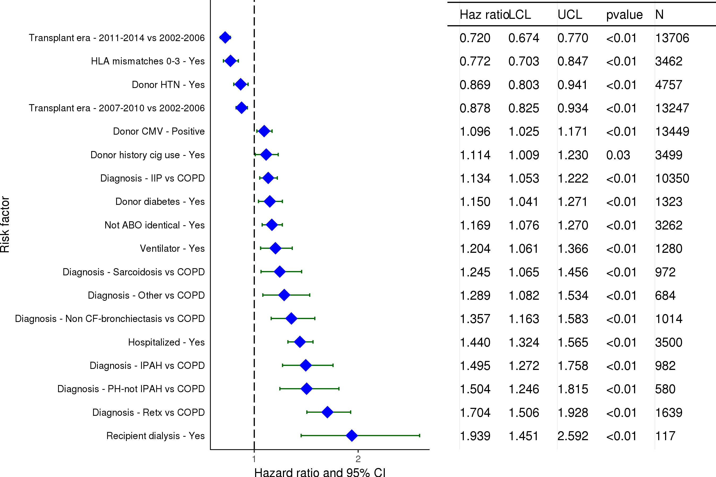
Adult Lung Transplants (2003-6/2015)
Statistically Significant Risk Factors For 1 Year Mortality with 95% Confidence Limits
2017
(N = 38,983)
JHLT. 2017 Oct; 36(10): 1037-1079

Slide 91
Adult Lung Transplants (2003-6/2015)
Statistically Significant Risk Factors For 1 Year Mortality
Continuous Factors (see figures)
Recipient age | Donor age
Recipient creatinine | Total bilirubin
Height difference | Recipient Oxygen Required at Rest
Recipient FVC% Predicted | Donor BMI
2017
JHLT. 2017 Oct; 36(10): 1037-1079

Slide 92
Adult Lung Transplants (2003-6/2015)
Recipient age
Risk Factors For 1 Year Mortality with 95% Confidence Limits
p < 0.0001
2017
(N = 38,983)
JHLT. 2017 Oct; 36(10): 1037-1079
Notes:
Multivariable analysis was performed using a proportional hazards model censoring all patients at 1 year. Continuous factors were fit using a restricted cubic spline.
Analyses were limited to transplants having essentially complete information regarding risk factors.

Slide 93
Adult Lung Transplants (2003-6/2015)
Donor age
Risk Factors For 1 Year Mortality with 95% Confidence Limits
p < 0.0001
2017
(N = 38,983)
JHLT. 2017 Oct; 36(10): 1037-1079
Notes:
Multivariable analysis was performed using a proportional hazards model censoring all patients at 1 year. Continuous factors were fit using a restricted cubic spline.
Analyses were limited to transplants having essentially complete information regarding risk factors.

Slide 94
Adult Lung Transplants (2003-6/2015)
Recipient creatinine
Risk Factors For 1 Year Mortality with 95% Confidence Limits
p < 0.0001
2017
(N = 38,983)
JHLT. 2017 Oct; 36(10): 1037-1079
Notes:
Multivariable analysis was performed using a proportional hazards model censoring all patients at 1 year. Continuous factors were fit using a restricted cubic spline.
Analyses were limited to transplants having essentially complete information regarding risk factors.

Slide 95
Adult Lung Transplants (2003-6/2015)
Total bilirubin
Risk Factors For 1 Year Mortality with 95% Confidence Limits
p < 0.0001
2017
(N = 38,983)
JHLT. 2017 Oct; 36(10): 1037-1079
Notes:
Multivariable analysis was performed using a proportional hazards model censoring all patients at 1 year. Continuous factors were fit using a restricted cubic spline.
Analyses were limited to transplants having essentially complete information regarding risk factors.

Slide 96
Adult Lung Transplants (2003-6/2015)
Height difference
Risk Factors For 1 Year Mortality with 95% Confidence Limits
p < 0.0001
2017
(N = 38,983)
JHLT. 2017 Oct; 36(10): 1037-1079
Notes:
Multivariable analysis was performed using a proportional hazards model censoring all patients at 1 year. Continuous factors were fit using a restricted cubic spline.
Analyses were limited to transplants having essentially complete information regarding risk factors.

Slide 97
Adult Lung Transplants (2003-6/2015)
Recipient Oxygen Required at Rest
Risk Factors For 1 Year Mortality with 95% Confidence Limits
p < 0.0001
2017
(N = 38,983)
JHLT. 2017 Oct; 36(10): 1037-1079
Notes:
Multivariable analysis was performed using a proportional hazards model censoring all patients at 1 year. Continuous factors were fit using a restricted cubic spline.
Analyses were limited to transplants having essentially complete information regarding risk factors.

Slide 98
Adult Lung Transplants (2003-6/2015)
Recipient FVC% Predicted
Risk Factors For 1 Year Mortality with 95% Confidence Limits
p < 0.0001
2017
(N = 38,983)
JHLT. 2017 Oct; 36(10): 1037-1079
Notes:
Multivariable analysis was performed using a proportional hazards model censoring all patients at 1 year. Continuous factors were fit using a restricted cubic spline.
Analyses were limited to transplants having essentially complete information regarding risk factors.

Slide 99
Adult Lung Transplants (2003-6/2015)
Donor BMI
Risk Factors For 1 Year Mortality with 95% Confidence Limits
p = 0.0007
2017
(N = 38,983)
JHLT. 2017 Oct; 36(10): 1037-1079
Notes:
Multivariable analysis was performed using a proportional hazards model censoring all patients at 1 year. Continuous factors were fit using a restricted cubic spline.
Analyses were limited to transplants having essentially complete information regarding risk factors.

Slide 100
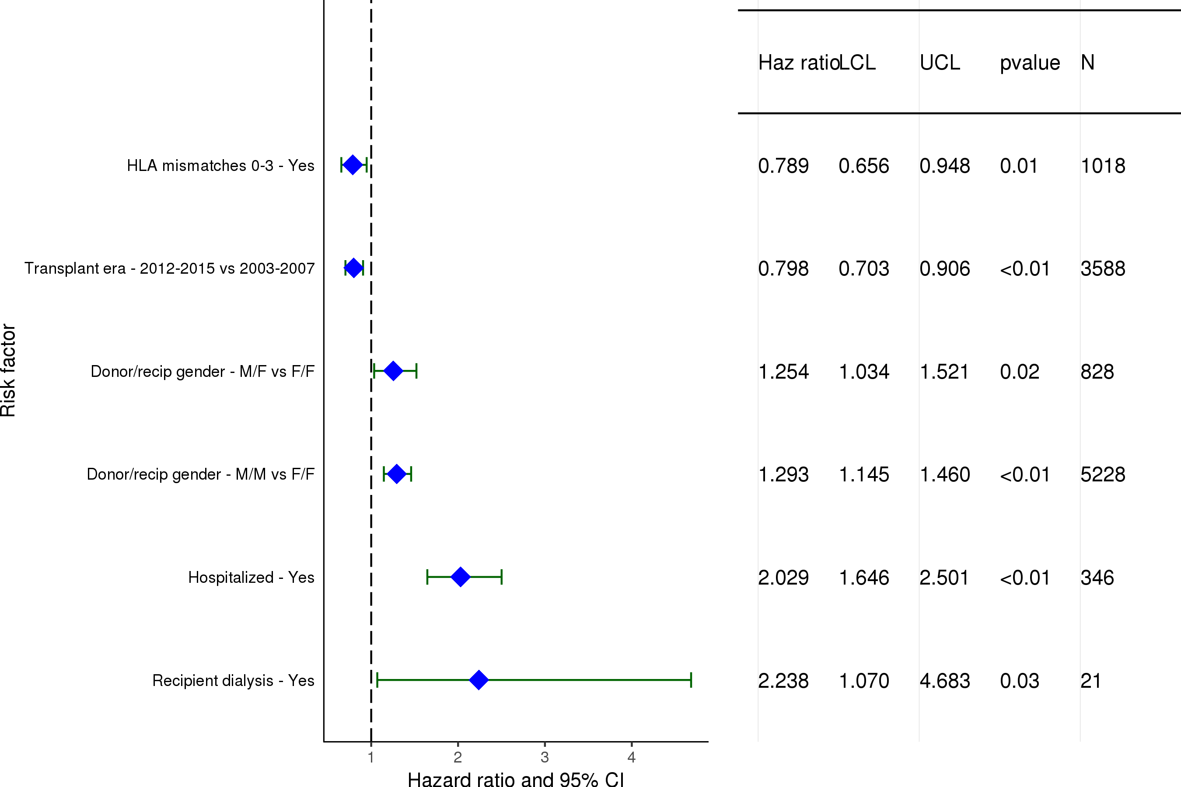
Adult Lung Transplants (2003-6/2015)
Statistically Significant Risk Factors For 1 Year Mortality with 95% Confidence Limits
Diagnosis = COPD
2017
(N = 11,339)
JHLT. 2017 Oct; 36(10): 1037-1079

Slide 101
Adult Lung Transplants (2003-6/2015)
Diagnosis = COPD
Statistically Significant Risk Factors For 1 Year Mortality
Continuous Factors (see figures)
Recipient age | Donor age
Center Volume: Previous Txs Within 1 Yr.
2017
JHLT. 2017 Oct; 36(10): 1037-1079

Slide 102
Adult Lung Transplants (2003-6/2015)
Diagnosis = COPD
Risk Factors For 1 Year Mortality with 95% Confidence Limits
Recipient age
p < 0.0001
2017
(N = 11,339)
JHLT. 2017 Oct; 36(10): 1037-1079
Notes:
Multivariable analysis was performed using a proportional hazards model censoring all patients at 1 years. Continuous factors were fit using a restricted cubic spline.

Slide 103
Adult Lung Transplants (2003-6/2015)
Diagnosis = COPD
Risk Factors For 1 Year Mortality with 95% Confidence Limits
Donor age
p = 0.0099
2017
(N = 11,339)
JHLT. 2017 Oct; 36(10): 1037-1079
Notes:
Multivariable analysis was performed using a proportional hazards model censoring all patients at 1 years. Continuous factors were fit using a restricted cubic spline.

Slide 104
Adult Lung Transplants (2003-6/2015)
Diagnosis = COPD
Risk Factors For 1 Year Mortality with 95% Confidence Limits
Center Volume: Previous Txs Within 1 Yr.
p < 0.0001
2017
(N = 11,339)
JHLT. 2017 Oct; 36(10): 1037-1079
Notes:
Multivariable analysis was performed using a proportional hazards model censoring all patients at 1 years. Continuous factors were fit using a restricted cubic spline.

Slide 105
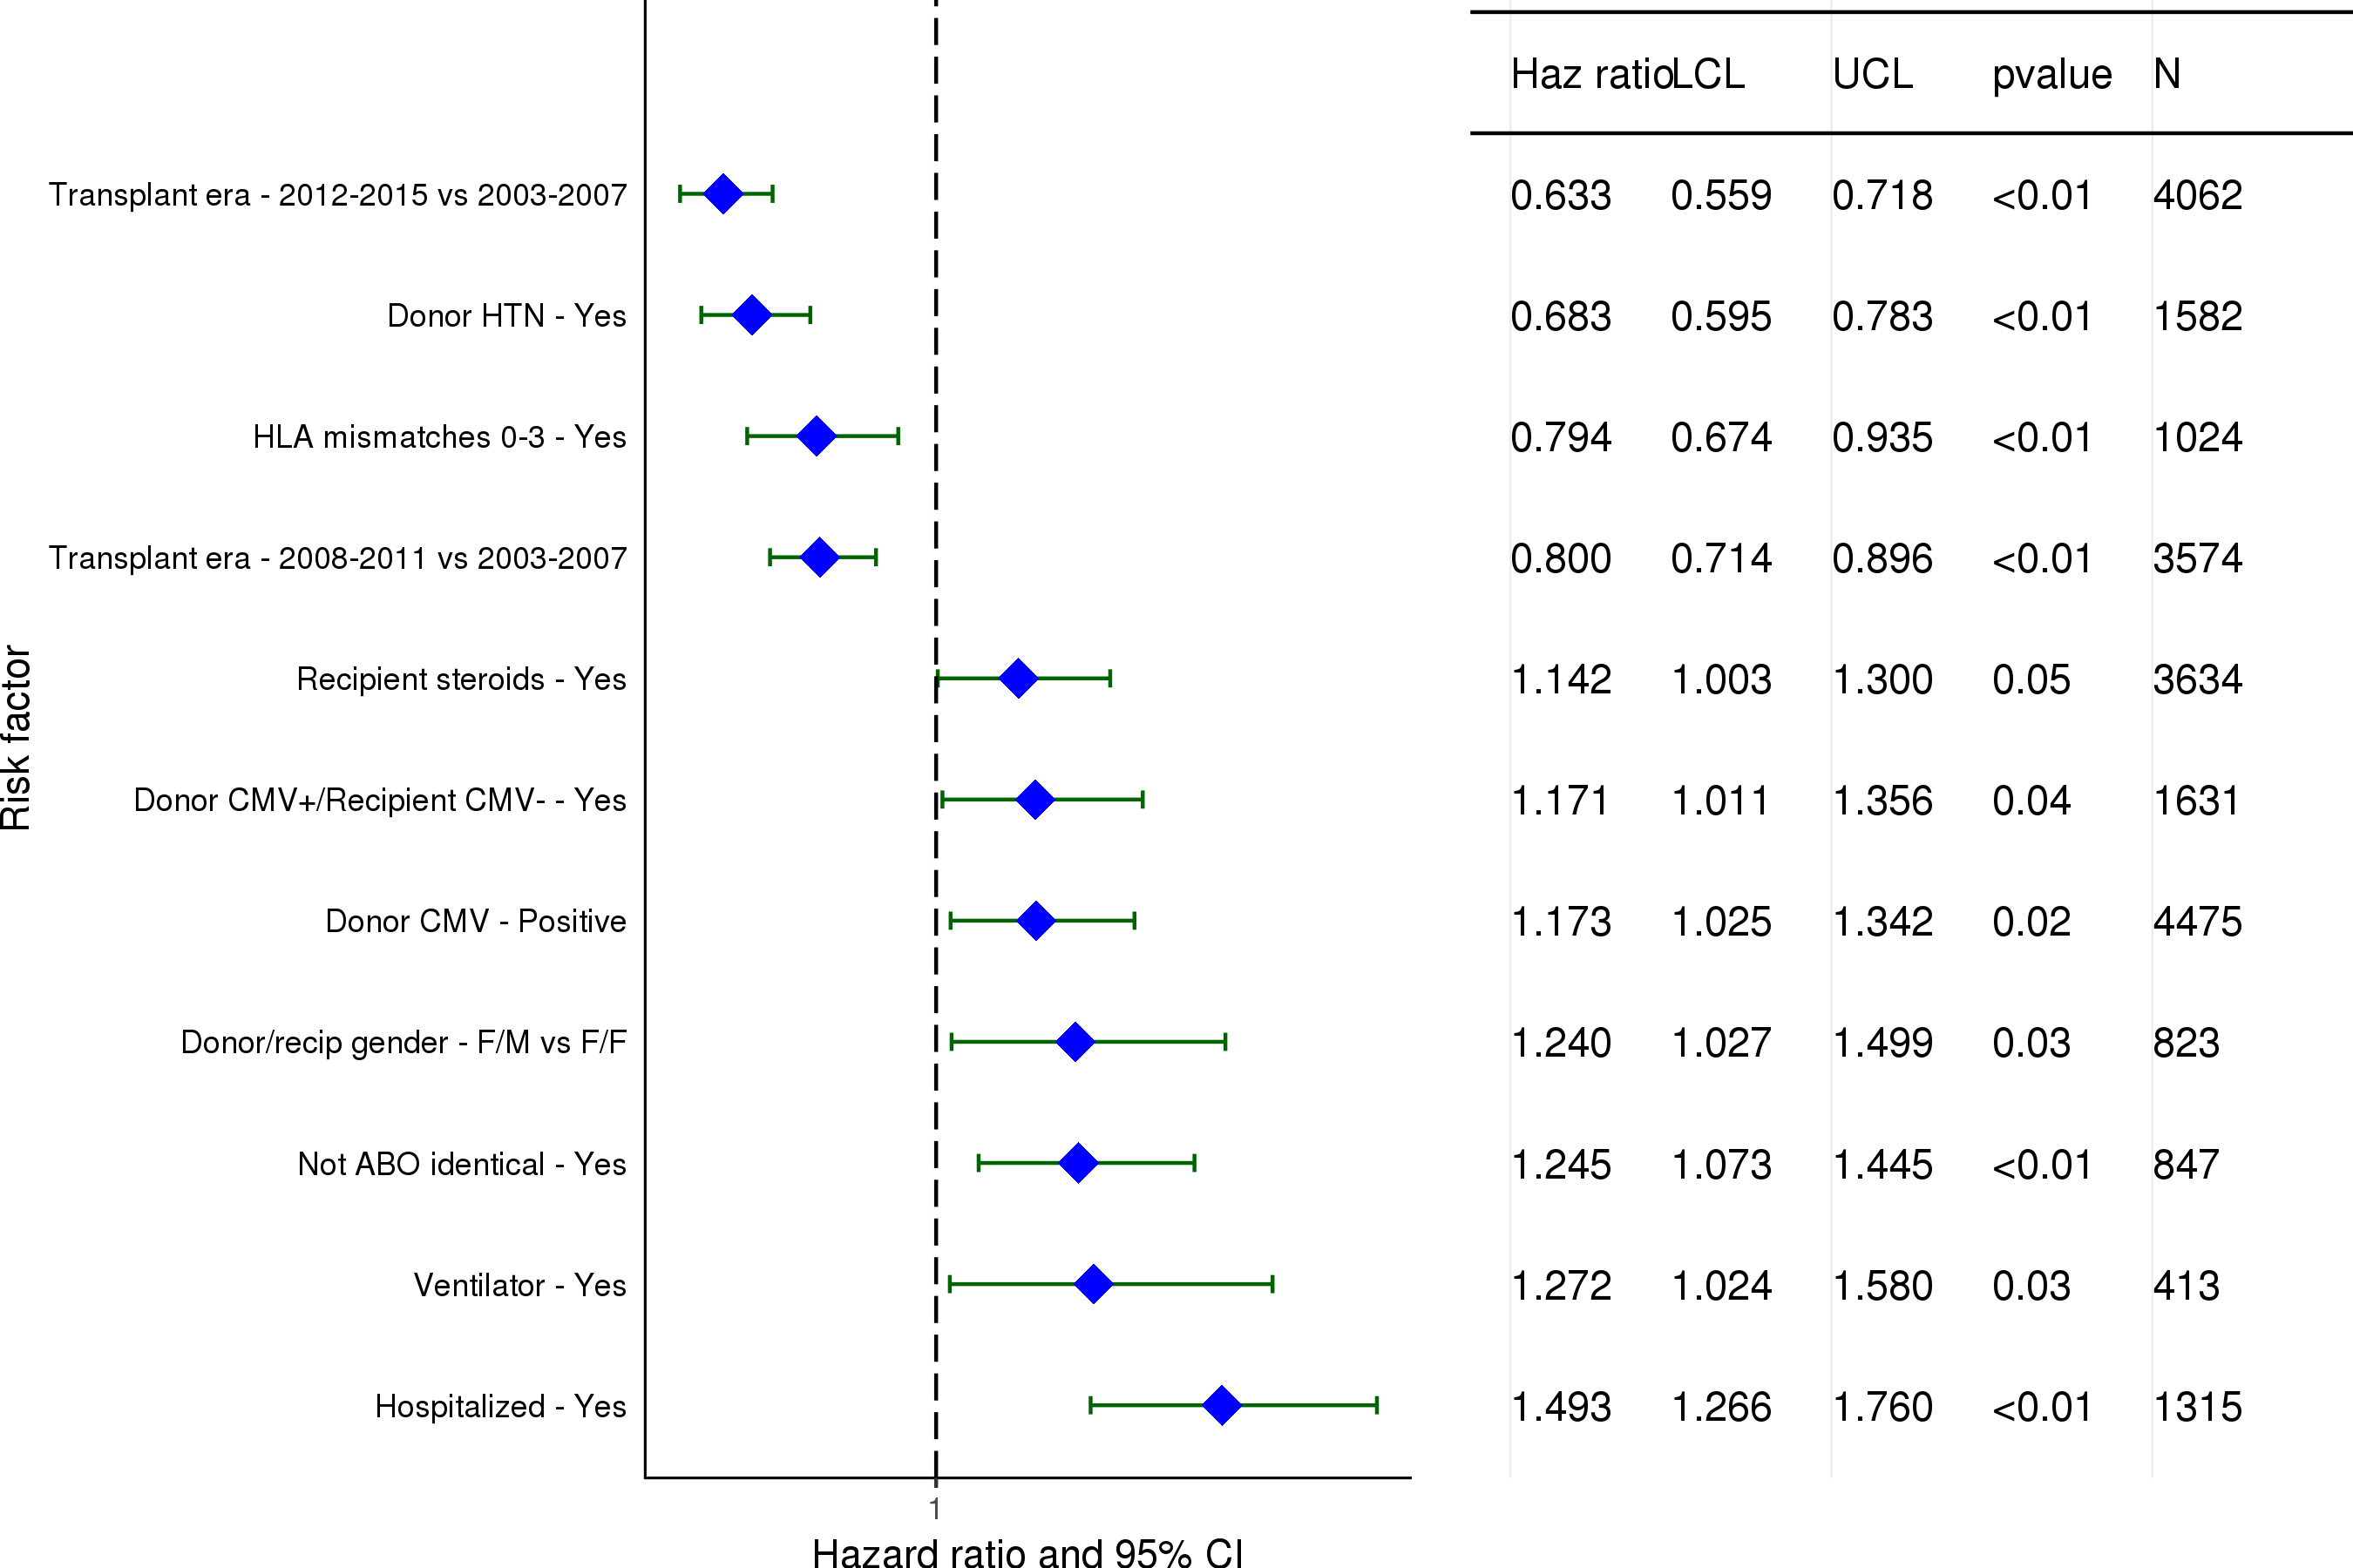
Adult Lung Transplants (2003-6/2015)
Statistically Significant Risk Factors For 1 Year Mortality with 95% Confidence Limits
Diagnosis = IIP
2017
(N = 10,350)
JHLT. 2017 Oct; 36(10): 1037-1079

Slide 106
Adult Lung Transplants (2003-6/2015)
Diagnosis = IIP
Statistically Significant Risk Factors For 1 Year Mortality
Continuous Factors (see figures)
Recipient age | Donor age
Total bilirubin | Height difference
Center Volume: Previous Txs Within 1 Yr. | Donor height
2017
JHLT. 2017 Oct; 36(10): 1037-1079

Slide 107
Adult Lung Transplants (2003-6/2015)
Diagnosis = IIP
Risk Factors For 1 Year Mortality with 95% Confidence Limits
Recipient age
p < 0.0001
2017
(N = 10,350)
JHLT. 2017 Oct; 36(10): 1037-1079
Notes:
Multivariable analysis was performed using a proportional hazards model censoring all patients at 1 year. Continuous factors were fit using a restricted cubic spline.

Slide 108
Adult Lung Transplants (2003-6/2015)
Diagnosis = IIP
Risk Factors For 1 Year Mortality with 95% Confidence Limits
Donor age
p < 0.0001
2017
(N = 10,350)
JHLT. 2017 Oct; 36(10): 1037-1079
Notes:
Multivariable analysis was performed using a proportional hazards model censoring all patients at 1 year. Continuous factors were fit using a restricted cubic spline.

Slide 109
Adult Lung Transplants (2003-6/2015)
Diagnosis = IIP
Risk Factors For 1 Year Mortality with 95% Confidence Limits
Total bilirubin
p = 0.0005
2017
(N = 10,350)
JHLT. 2017 Oct; 36(10): 1037-1079
Notes:
Multivariable analysis was performed using a proportional hazards model censoring all patients at 1 year. Continuous factors were fit using a restricted cubic spline.

Slide 110
Adult Lung Transplants (2003-6/2015)
Diagnosis = IIP
Risk Factors For 1 Year Mortality with 95% Confidence Limits
Height difference (donor – recipient height)
p = 0.0142
2017
(N = 10,350)
JHLT. 2017 Oct; 36(10): 1037-1079
Notes:
Multivariable analysis was performed using a proportional hazards model censoring all patients at 1 year. Continuous factors were fit using a restricted cubic spline.

Slide 111
Adult Lung Transplants (2003-6/2015)
Diagnosis = IIP
Risk Factors For 1 Year Mortality with 95% Confidence Limits
Center Volume: Previous Txs Within 1 Yr.
p < 0.0001
2017
(N = 10,350)
JHLT. 2017 Oct; 36(10): 1037-1079
Notes:
Multivariable analysis was performed using a proportional hazards model censoring all patients at 1 year. Continuous factors were fit using a restricted cubic spline.

Slide 112
Adult Lung Transplants (2003-6/2015)
Diagnosis = IIP
Risk Factors For 1 Year Mortality with 95% Confidence Limits
Donor height
p = 0.0166
2017
(N = 10,350)
JHLT. 2017 Oct; 36(10): 1037-1079
Notes:
Multivariable analysis was performed using a proportional hazards model censoring all patients at 1 year. Continuous factors were fit using a restricted cubic spline.

Slide 113
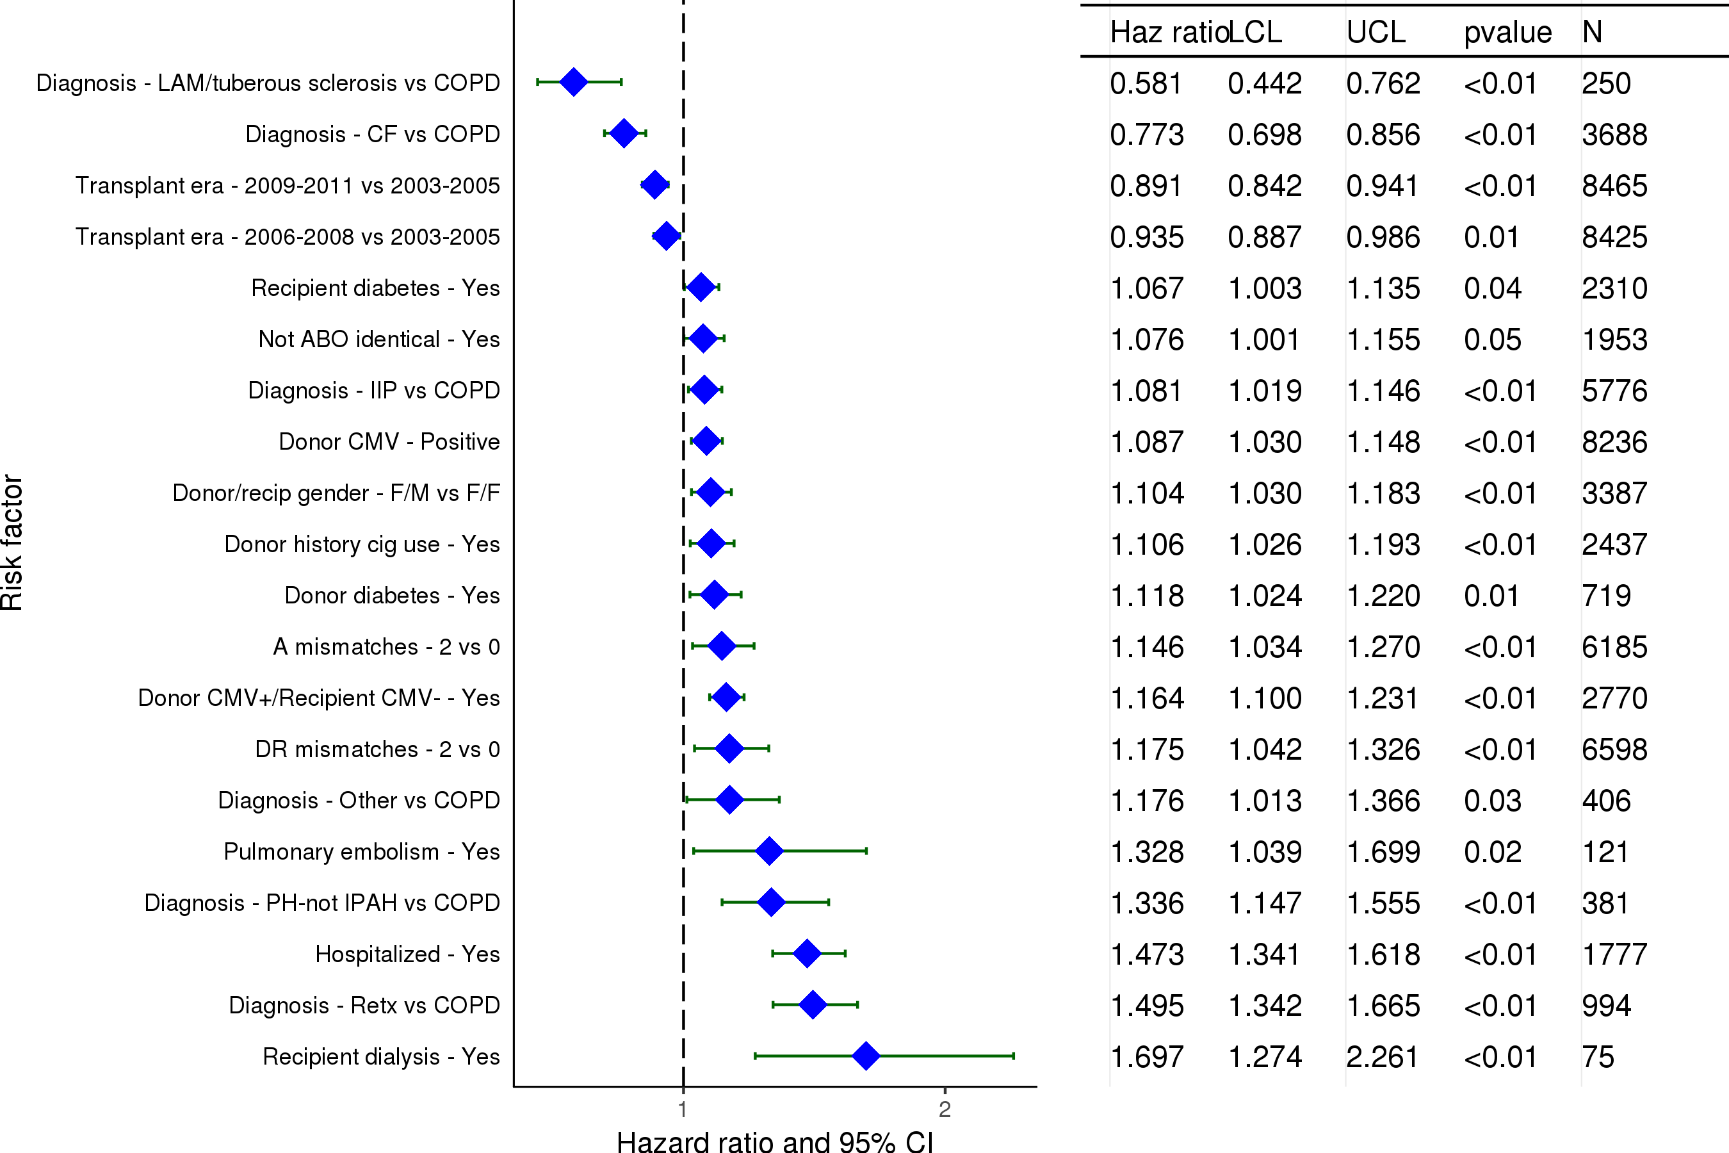
Adult Lung Transplants (2003-6/2011)
Statistically Significant Risk Factors For 5 Year Mortality with 95% Confidence Limits
2017
(N = 23,395)
JHLT. 2017 Oct; 36(10): 1037-1079

Slide 114
Adult Lung Transplants (2003-6/2011)
Statistically Significant Risk Factors For 5 Year Mortality
Continuous Factors (see figures)
Recipient age | Donor age
BMI ratio | Height difference
Recipient Oxygen Required at Rest
2017
JHLT. 2017 Oct; 36(10): 1037-1079

Slide 115
Adult Lung Transplants (2003-6/2011)
Recipient age
Risk Factors For 5 Year Mortality with 95% Confidence Limits
p < 0.0001
2017
(N = 23,395)
JHLT. 2017 Oct; 36(10): 1037-1079
Notes:
Multivariable analysis was performed using a proportional hazards model censoring all patients at 5 years. Continuous factors were fit using a restricted cubic spline.

Slide 116
Adult Lung Transplants (2003-6/2011)
Donor age
Risk Factors For 5 Year Mortality with 95% Confidence Limits
p < 0.0001
2017
(N = 23,395)
JHLT. 2017 Oct; 36(10): 1037-1079
Notes:
Multivariable analysis was performed using a proportional hazards model censoring all patients at 5 years. Continuous factors were fit using a restricted cubic spline.

Slide 117
Adult Lung Transplants (2003-6/2011)
BMI ratio (donor BMI/recipient BMI)
Risk Factors For 5 Year Mortality with 95% Confidence Limits
p = 0.0157
2017
(N = 23,395)
JHLT. 2017 Oct; 36(10): 1037-1079
Notes:
Multivariable analysis was performed using a proportional hazards model censoring all patients at 5 years. Continuous factors were fit using a restricted cubic spline.

Slide 118
Adult Lung Transplants (2003-6/2011)
Height difference (donor – recipient height)
Risk Factors For 5 Year Mortality with 95% Confidence Limits
p = 0.0464
2017
(N = 23,395)
JHLT. 2017 Oct; 36(10): 1037-1079
Notes:
Multivariable analysis was performed using a proportional hazards model censoring all patients at 5 years. Continuous factors were fit using a restricted cubic spline.

Slide 119
Adult Lung Transplants (2003-6/2011)
Recipient Oxygen Required at Rest
Risk Factors For 5 Year Mortality with 95% Confidence Limits
p = 0.0218
2017
(N = 23,395)
JHLT. 2017 Oct; 36(10): 1037-1079
Notes:
Multivariable analysis was performed using a proportional hazards model censoring all patients at 5 years. Continuous factors were fit using a restricted cubic spline.

Slide 120
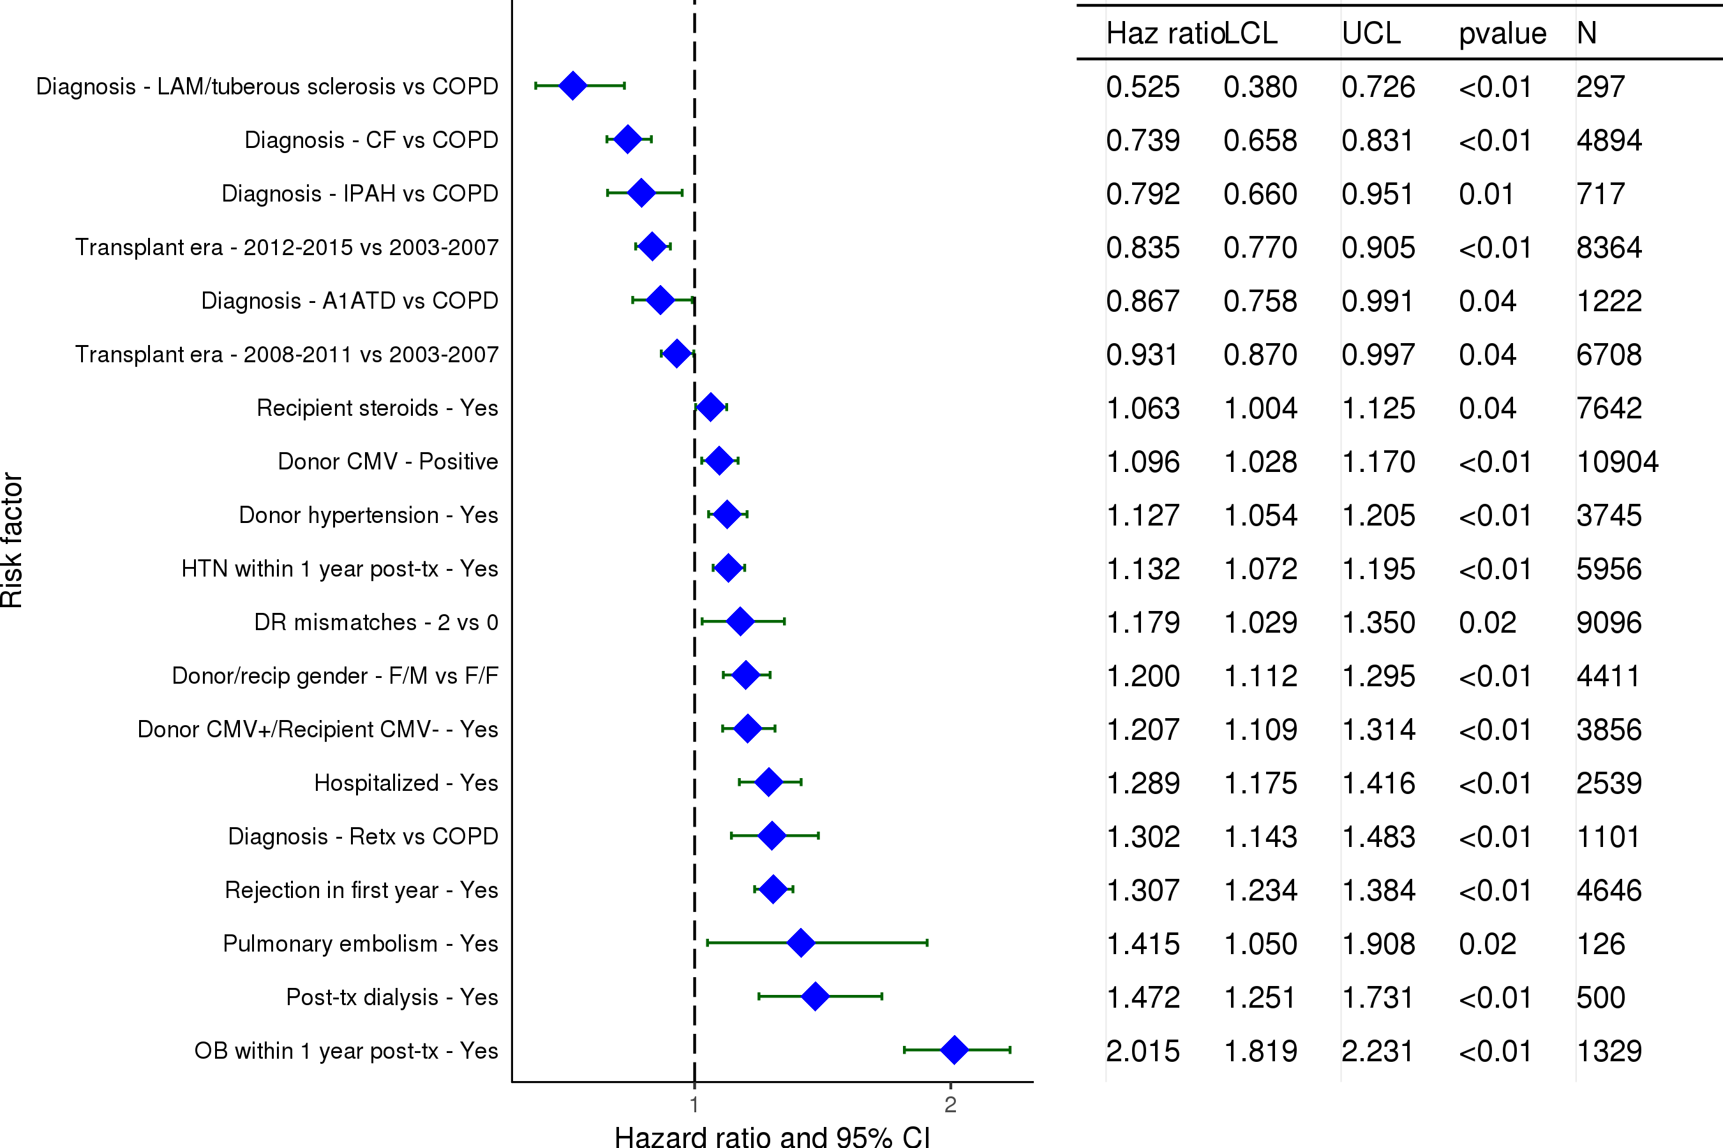
Adult Lung Transplants (2003-6/2011)
Statistically Significant Risk Factors For 5 Year Mortality with 95% Confidence Limits
Conditional on Survival to 1 Year
2017
(N = 30,404)
JHLT. 2017 Oct; 36(10): 1037-1079

Slide 121
Adult Lung Transplants (2003-6/2011)
Statistically Significant Risk Factors For 5 Year Mortality
Conditional on Survival to 1 Year
Continuous Factors (see figures)
Recipient age | Recipient creatinine
BMI ratio | Center Volume: Previous Txs Within 1 Yr.
Ischemic time
2017
JHLT. 2017 Oct; 36(10): 1037-1079

Slide 122
Adult Lung Transplants (2003-6/2011)
Risk Factors For 5 Year Mortality with 95% Confidence Limits
Conditional on Survival to 1 Year
Recipient age
p < 0.0001
2017
(N = 30,404)
JHLT. 2017 Oct; 36(10): 1037-1079
Notes:
Multivariable analysis was performed using a proportional hazards model censoring all patients at 5 years. Continuous factors were fit using a restricted cubic spline.

Slide 123
Adult Lung Transplants (2003-6/2011)
Risk Factors For 5 Year Mortality with 95% Confidence Limits
Conditional on Survival to 1 Year
Recipient creatinine
p = 0.0107
2017
(N = 30,404)
JHLT. 2017 Oct; 36(10): 1037-1079
Notes:
Multivariable analysis was performed using a proportional hazards model censoring all patients at 5 years. Continuous factors were fit using a restricted cubic spline.

Slide 124
Adult Lung Transplants (2003-6/2011)
Risk Factors For 5 Year Mortality with 95% Confidence Limits
Conditional on Survival to 1 Year
BMI ratio (donor BMI/recipient BMI)
p = 0.0239
2017
(N = 30,404)
JHLT. 2017 Oct; 36(10): 1037-1079
Notes:
Multivariable analysis was performed using a proportional hazards model censoring all patients at 5 years. Continuous factors were fit using a restricted cubic spline.

Slide 125
Adult Lung Transplants (2003-6/2011)
Risk Factors For 5 Year Mortality with 95% Confidence Limits
Conditional on Survival to 1 Year
Center Volume: Previous Txs Within 1 Yr.
p < 0.0001
2017
(N = 30,404)
JHLT. 2017 Oct; 36(10): 1037-1079
Notes:
Multivariable analysis was performed using a proportional hazards model censoring all patients at 5 years. Continuous factors were fit using a restricted cubic spline.

Slide 126
Adult Lung Transplants (2003-6/2011)
Risk Factors For 5 Year Mortality with 95% Confidence Limits
Conditional on Survival to 1 Year
Ischemic time
p = 0.0015
2017
(N = 30,404)
JHLT. 2017 Oct; 36(10): 1037-1079
Notes:
Multivariable analysis was performed using a proportional hazards model censoring all patients at 5 years. Continuous factors were fit using a restricted cubic spline.

Slide 127
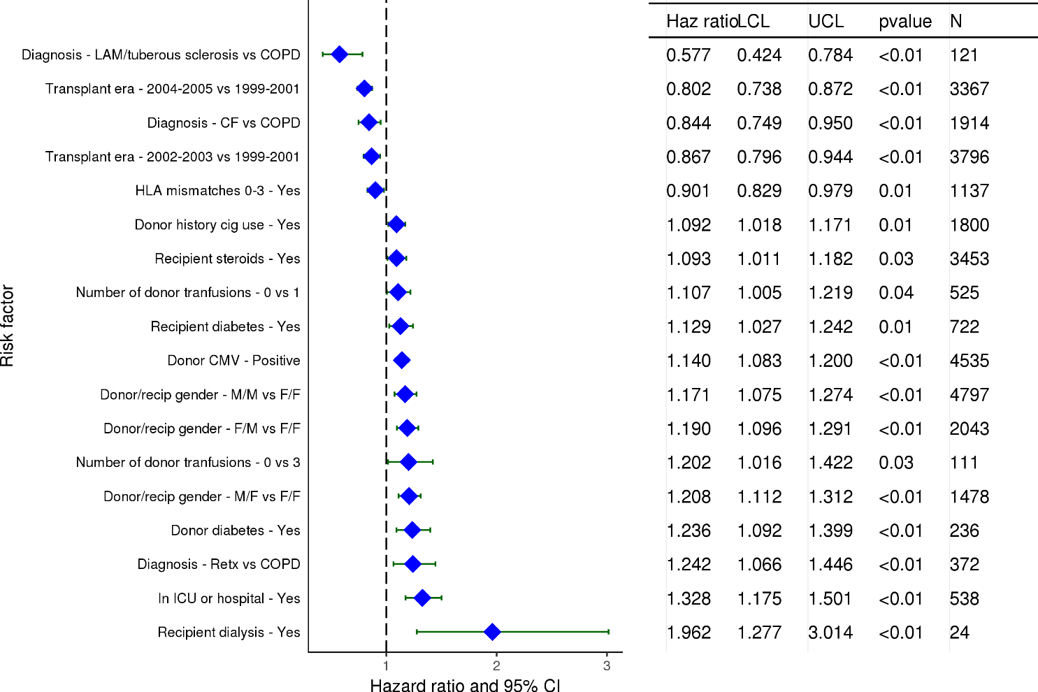
Adult Lung Transplants (1999-6/2005)
Statistically Significant Risk Factors For 10 Year Mortality with 95% Confidence Limits
2017
(N = 11,939)
JHLT. 2017 Oct; 36(10): 1037-1079

Slide 128
Adult Lung Transplants (1999-6/2005)
Statistically Significant Risk Factors For 10 Year Mortality
Continuous Factors (see figures)
Recipient age | Donor age
Recipient creatinine | BMI ratio
Oxygen requirement | Donor height
Ischemic time
2017
JHLT. 2017 Oct; 36(10): 1037-1079

Slide 129
Adult Lung Transplants (1999-6/2005)
Recipient age
Risk Factors For 10 Year Mortality with 95% Confidence Limits
p < 0.0001
2017
(N = 11,939)
JHLT. 2017 Oct; 36(10): 1037-1079
Notes:
Multivariable analysis was performed using a proportional hazards model censoring all patients at 10 years. Continuous factors were fit using a restricted cubic spline.
Analyses were limited to transplants having essentially complete information regarding risk factors.

Slide 130
Adult Lung Transplants (1999-6/2005)
Donor age
Risk Factors For 10 Year Mortality with 95% Confidence Limits
p = 0.0007
2017
(N = 11,939)
JHLT. 2017 Oct; 36(10): 1037-1079
Notes:
Multivariable analysis was performed using a proportional hazards model censoring all patients at 10 years. Continuous factors were fit using a restricted cubic spline.
Analyses were limited to transplants having essentially complete information regarding risk factors.

Slide 131
Adult Lung Transplants (1999-6/2005)
Recipient creatinine
Risk Factors For 10 Year Mortality with 95% Confidence Limits
p = 0.0098
2017
(N = 11,939)
JHLT. 2017 Oct; 36(10): 1037-1079
Notes:
Multivariable analysis was performed using a proportional hazards model censoring all patients at 10 years. Continuous factors were fit using a restricted cubic spline.
Analyses were limited to transplants having essentially complete information regarding risk factors.

Slide 132
Adult Lung Transplants (1999-6/2005)
BMI ratio
Risk Factors For 10 Year Mortality with 95% Confidence Limits
p < 0.0001
2017
(N = 11,939)
JHLT. 2017 Oct; 36(10): 1037-1079
Notes:
Multivariable analysis was performed using a proportional hazards model censoring all patients at 10 years. Continuous factors were fit using a restricted cubic spline.
Analyses were limited to transplants having essentially complete information regarding risk factors.

Slide 133
Adult Lung Transplants (1999-6/2005)
Oxygen requirement
Risk Factors For 10 Year Mortality with 95% Confidence Limits
p = 0.0003
2017
(N = 11,939)
JHLT. 2017 Oct; 36(10): 1037-1079
Notes:
Multivariable analysis was performed using a proportional hazards model censoring all patients at 5 years. Continuous factors were fit using a restricted cubic spline.
Analyses were limited to transplants having essentially complete information regarding risk factors.

Slide 134
Adult Lung Transplants (1999-6/2005)
Donor height
Risk Factors For 10 Year Mortality with 95% Confidence Limits
p = 0.0316
2017
(N = 11,939)
JHLT. 2017 Oct; 36(10): 1037-1079
Notes:
Multivariable analysis was performed using a proportional hazards model censoring all patients at 5 years. Continuous factors were fit using a restricted cubic spline.
Analyses were limited to transplants having essentially complete information regarding risk factors.

Slide 135
Adult Lung Transplants (1999-6/2005)
Ischemic time
Risk Factors For 10 Year Mortality with 95% Confidence Limits
p = 0.0156
2017
(N = 11,939)
JHLT. 2017 Oct; 36(10): 1037-1079
Notes:
Multivariable analysis was performed using a proportional hazards model censoring all patients at 5 years. Continuous factors were fit using a restricted cubic spline.
Analyses were limited to transplants having essentially complete information regarding risk factors.

Slide 136
Focus Theme
2017
JHLT. 2017 Oct; 36(10): 1037-1079

Slide 137
Adult Lung Transplants Ischemic Time Distribution by Diagnosis
(Transplants: January 2009 – June 2016)
2017
JHLT. 2017 Oct; 36(10): 1037-1079

Slide 138
Adult Lung Transplants Ischemic Time Distribution by Recipient Age
(Transplants: January 2009 – June 2016)
2017
JHLT. 2017 Oct; 36(10): 1037-1079

Slide 139
Adult Lung Transplants Ischemic Time Distribution by Recipient Ventilator Support
at Transplant
(Transplants: January 2009 – June 2016)
2017
JHLT. 2017 Oct; 36(10): 1037-1079

Slide 140
Adult Lung Transplants Ischemic Time Distribution by Donor Age
(Transplants: January 2009 – June 2016)
2017
JHLT. 2017 Oct; 36(10): 1037-1079

Slide 141
Adult Lung Transplants Ischemic Time Distribution by Donor Cause of Death
(Transplants: January 2009 – June 2016)
2017
JHLT. 2017 Oct; 36(10): 1037-1079

Slide 142
Adult Lung Transplants Ischemic Time Distribution by Year of Transplant
2017
JHLT. 2017 Oct; 36(10): 1037-1079

Slide 143
Adult Lung Transplants Ischemic Time Distribution by Location
(Transplants: January 2009 – June 2016)
2017
JHLT. 2017 Oct; 36(10): 1037-1079

Slide 144
Adult Lung Transplants Ischemic Time Distribution by Center Volume
(Transplants: January 2009 – June 2016)
2017
JHLT. 2017 Oct; 36(10): 1037-1079

Slide 145
Adult Lung Transplants Ischemic Time Distribution by Procedure Type
(Transplants: January 2009 – June 2016)
2017
Ischemic time (hours): mean/median
bilateral/double lung = 5.7/5.5, single lung = 4.3/4.2
JHLT. 2017 Oct; 36(10): 1037-1079

Slide 146
Adult Lung Transplants Kaplan-Meier Survival Within 30 Days by Ischemic Time
(Transplants: January 2009 – June 2015)
No pair-wise comparisons were significant at p < 0.005 except 4-<6 vs. 6+ hours.
2017
JHLT. 2017 Oct; 36(10): 1037-1079
Notes:
Survival was calculated using the Kaplan-Meier method, which incorporates information from all transplants for whom any follow-up has been provided. Since many patients are still alive and some patients have been lost to follow-up, the survival rates are estimates rather than exact rates because the time of death is not known for all patients.
Survival rates were compared using the log-rank test statistic. Adjustments for multiple comparisons were done using Scheffe’s method. Results of log-rank test should be interpreted with caution when curves cross.

Slide 147
Adult Lung Transplants Kaplan-Meier Survival by Ischemic Time
(Transplants: January 2009 – June 2015)
No pair-wise comparisons were significant at p < 0.005 except 2-<4 vs. 6+ hours.
2017
JHLT. 2017 Oct; 36(10): 1037-1079
Notes:
Survival was calculated using the Kaplan-Meier method, which incorporates information from all transplants for whom any follow-up has been provided. Since many patients are still alive and some patients have been lost to follow-up, the survival rates are estimates rather than exact rates because the time of death is not known for all patients.
Survival rates were compared using the log-rank test statistic. Adjustments for multiple comparisons were done using Scheffe’s method. Results of log-rank test should be interpreted with caution when curves cross.

Slide 148
Adult Lung Transplants Percentage Experiencing Treated Rejection between Discharge and 1-Year Follow-Up by Ischemic Time
(Transplants: January 2009 – June 2015)
All pair-wise comparisons were significant at p < 0.05 except 0-<2 vs. 2-<4 hours.
Analysis is limited to patients who were alive at the time of the follow-up.
Treated rejection = Recipient was reported to (1) have at least one acute rejection episode that was treated with an anti-rejection agent; or (2) have been hospitalized for rejection.
2017
JHLT. 2017 Oct; 36(10): 1037-1079
Notes:
Comparisons were made using the chi-square statistic. Adjustments for multiple comparisons were done using Bonferroni method.

Slide 149
Adult Lung Transplants Freedom from Bronchiolitis Obliterans Syndrome
by Ischemic Time
(Transplants: January 2009 – June 2015)
No pair-wise comparisons were significant at p < 0.05 except 2-<4 vs. 6+ and 4-<6 vs. 6+ hours.
2017
JHLT. 2017 Oct; 36(10): 1037-1079
Notes:
Freedom from Bronchiolitis Obliterans Syndrome rates were computed using the Kaplan-Meier method.
The development of bronchiolitis obliterans is reported on annual follow-ups; a date of diagnosis is not provided. For this figure the midpoint between the date of previous follow-up (when event had not occurred) and the date of follow-up when the event was reported was used as the date of occurrence. Patients were included in the analysis until an unknown response for bronchiolitis obliterans was reported. Therefore, the rates seen here may differ from those reported in the cumulative prevalence slide which is based on only those patients with known responses for bronchiolitis obliterans at all follow-up time points.
Rates were compared using the log-rank test statistic. Adjustments for multiple comparisons were done using Scheffe’s method.

